Slide 1
Healthy Start Monitoring and Evaluation Data System – HSMED Validation Tool Training
July 02, 2024
Notes:
Good afternoon. On behalf of MCHB and the REI Systems development team, welcome and thank you for attending today’s Healthy Start Monitoring and Evaluation Data System - HSMED Validation Tool Training.

Slide 2
Table of Contents
HSMED Validation Tool Description
Login and Navigation
HSMED Validation Tool
Validating Client-Level Data
Schema Validations
Data Validation Report
Download Data
HSMED Validation Tool – Exceptions
Correcting Data
Notes:
Today we will be covering the accessing of HSMED Validation Tool and using it for file uploads. We’ve broken up our training into 9 main topics: HSMED Validation Tool Description, Login and Navigation, HSMED Validation Tool, Uploading Client-Level Data, Schema Validations, Data Validation Report, HSMED Validation Tool – Exceptions and Correcting Data.

Slide 3
HSMED Validation Tool
The HSMED Validation Tool allows grant recipients to validate their HSMED files against the schema and data validation rules prior to upload in the live system.
Strengthens data integrity across reporting requirements, adding substantial value to our operations.
Enables users to run test data to ensure files are correctly generated before processing real client-level data.
The PPUID and dependent validations with other forms will not be tested with this validation tool.
Notes:
First off, what is HSMED Validation Tool? The HSMED Validation Tool allows grant recipients to validate their HSMED files against the schema and data validation rules prior to upload in the live system. The purpose of this tool is to allow grantees to run their files against the schema without potentially uploading the test data. The new validation tool for HSMED grant recipients strengthens data integrity across reporting requirements, adding substantial value to our operations. The validation toll enables the grantee users to run test data to verify if their files are generated correctly before running real client-level data through the HSMED schema or data validations.
The PPUID and dependent validations with other forms will not be tested with this validation tool.

Slide 4
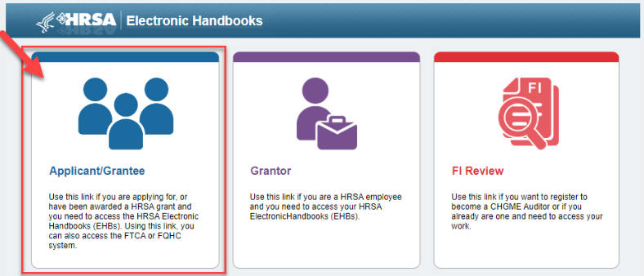
Login and Navigation
To access the EHBs, from grants.hrsa.gov select the Applicant/Grantee card. Review the warning banner and click Ok to continue to the EHBs. login page.
Notes:
To access the EHBs, from grants.hrsa.gov select the Applicant/Grantee card. Review the warning banner and click Ok to continue to the EHBs login page.

Slide 5
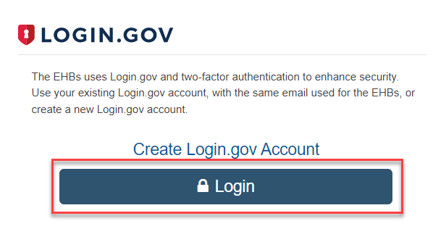
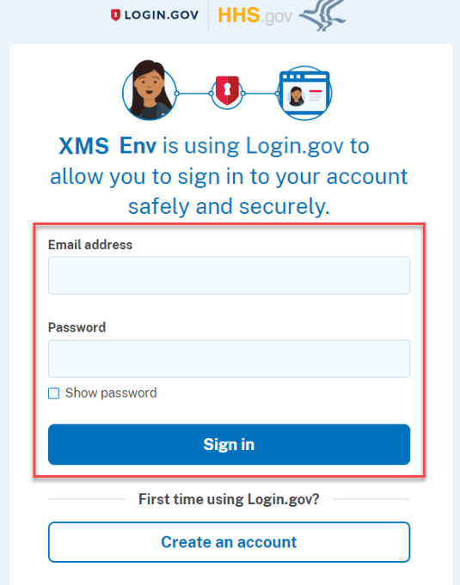
Login and Navigation
To access the HSMED Validation Tool, select Login to access the EHBs. Enter your Login.gov Email Address and Password, and click Sign in.
Important Note: The email address used for Login.gov must match the email address used in the EHBs.
Notes:
To access the HSMED Validation Tool, select Login to access the EHBs. Enter your Login.gov Email Address and Password, and click Sign in.
The email address used for Login.gov must match the email address used in the EHBs. Once signed in, you will navigate to EHBs Home page.

Slide 6
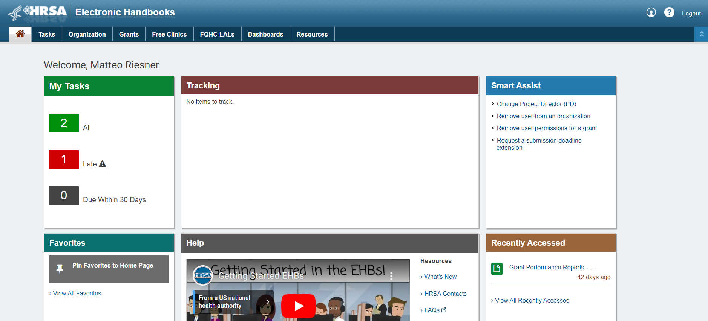
Login and Navigation (Cont.)
On the Home page, click the “Tasks” tab or the “All” button in the “My Tasks” pane to view the Tasks page.
Notes:
On the home page, click the “Tasks” tab or the “All” button in the “My Tasks” pane to view the Tasks page.

Slide 7
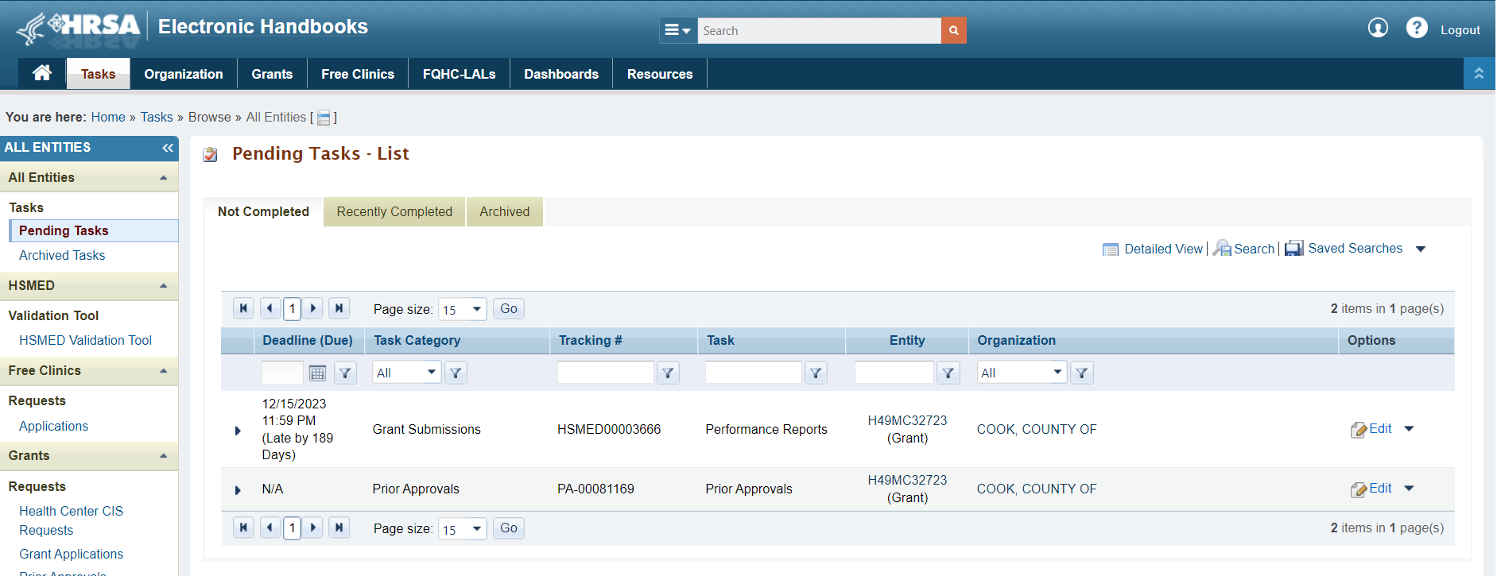
Tasks Page
On the left menu of the Tasks page, you will find the validation tool link named ‘HSMED Validation Tool’.
Notes:
On the Tasks page, the HSMED Validation Tool link will be available in the left menu for all the grantees.

Slide 8
HSMED Validation Tool - Access Denied
This link will be available on the left menu for all the grantees but only the H49 grantees with access will be able to view the HSMED Validation Tool page and upload the test files for testing.
The HSMED - Access Denied message will display when a non-HSMED user tries to access the "HSMED Validation Tool" page.
Notes:
The HSMED Validation Tool link will be available in the left menu for all the grantees but only the H49 grantees with access will be able to view the HSMED Validation Tool page and upload the test files for testing.
The HSMED - Access Denied message will display when a non HSMED user tries to access the "HSMED Validation Tool" page. And the user will not be able to view HSMED Validation Tool page or upload any files for testing.

Slide 9
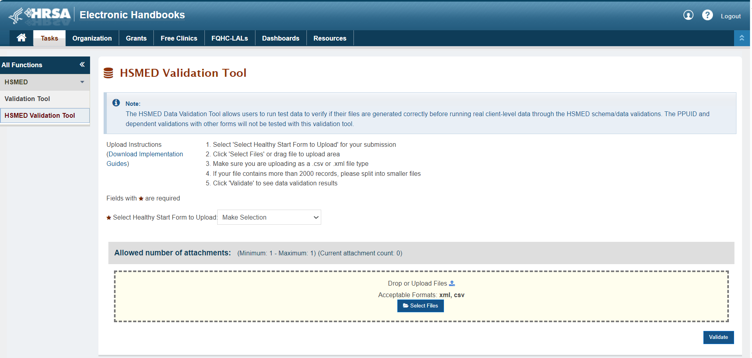
HSMED Validation Tool
On the Tasks page, click on the “HSMED Validation Tool” link from the left menu to view the HSMED Validation Tool page.
Notes:
As the grantee clicks on the HSMED Validation Tool link from the left menu, they will be navigated to HSMED Validation tool page.

Slide 10
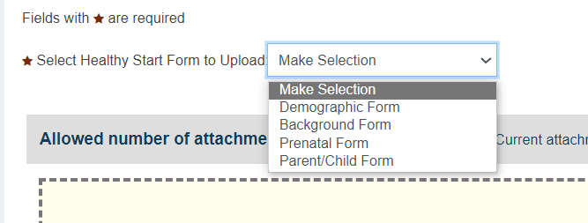
HSMED Validation Tool (cont.)
The following Healthy Start forms can be uploaded and tested using the HSMED validation tool
Demographic Form
Background Form
Prenatal Form
Parent/Child Form
Notes:
The Healthy Start forms that can be uploaded and tested using the HSMED validation tool are
Demographic Form
Background Form
Prenatal Form
Parent/Child Form

Slide 11
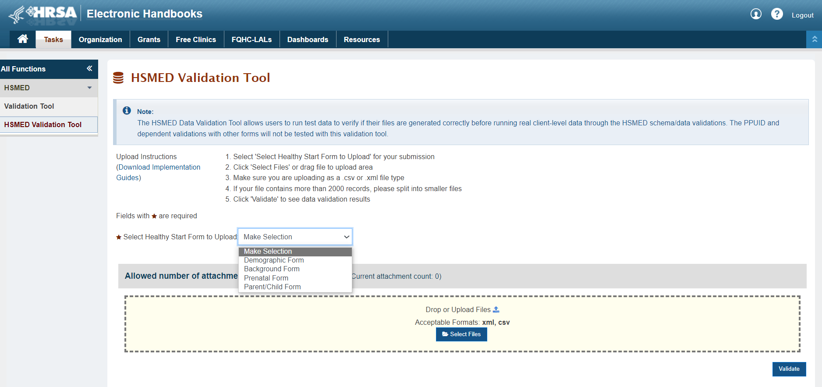
HSMED Validation Tool (cont.)
On the HSMED Validation Tool page, you can confirm your grant information and validate files. Choose the Healthy Start form you want to validate. Click “Select Files” to choose the file for upload. HSMED Validation Tool accepts files in both CSV and XML format.
Notes:
On the HSMED Validation Tool page, you can confirm your grant information and upload files for your report to test.
Select the Healthy Start form you are uploading and click “Select Files” to select the file you would like to upload.
You may also drag a file into the drop area to upload. However, Internet Explorer does not allow you to drag and drop. If you choose to use IE, you will be required to select files using the “Select Files” button.
HSMED Validation Tool accepts files in both CSV and XML format.

Slide 12
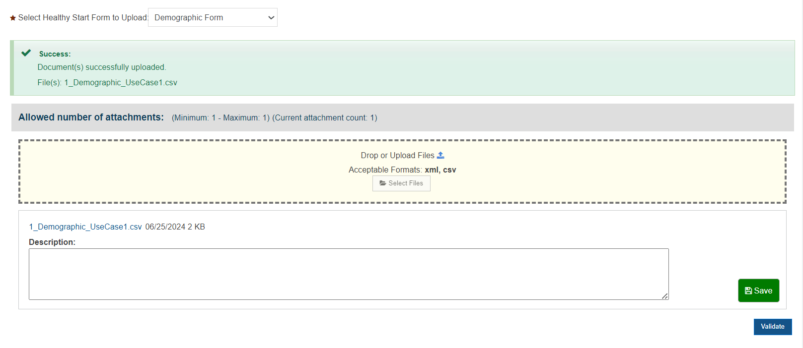
Validating Client-Level Data
The selected file will appear in the Attachment box. The HSMED validation tool doesn’t Save files that are uploaded but you must click the “Save” button to access the “Delete” button.
Notes:
Once you’ve selected a file, you will see it show directly underneath the upload box. You will not be able to select additional files or drag new files into the upload area, since you can upload only one file at a time. The HSMED validation tool doesn’t Save files that are uploaded but you must click the “Save” button to access the “Delete” button.

Slide 13
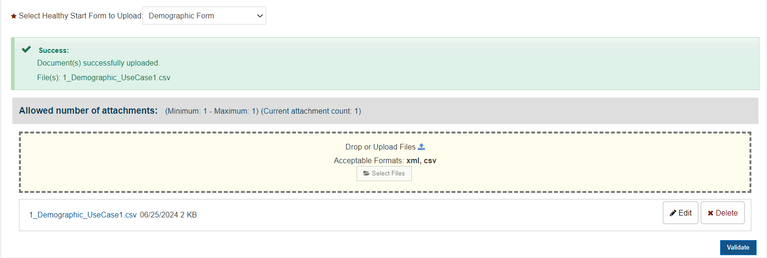
Validating Client-Level Data (cont.)
The selected file will appear in the Attachment box with “Edit and “Delete” buttons once saved. Click “Delete” to remove the file and attach a new one. Click “Validate” to start the validation process.
Notes:
Once you click on “Save” button, you will see the file show directly underneath the upload box. You may click “Delete” to remove the file and attach a new file.
The “Edit” button does not provide any additional functionality in the HSMED system. Values entered in the description field that shows when you click “Edit” are not saved to HSMED. This button is a legacy function that is sometimes used for other reports on EHBs, but it does not provide any function in HSMED.
Once you’ve selected the correct file, click “Validate” to initiate validation of the file.

Slide 14
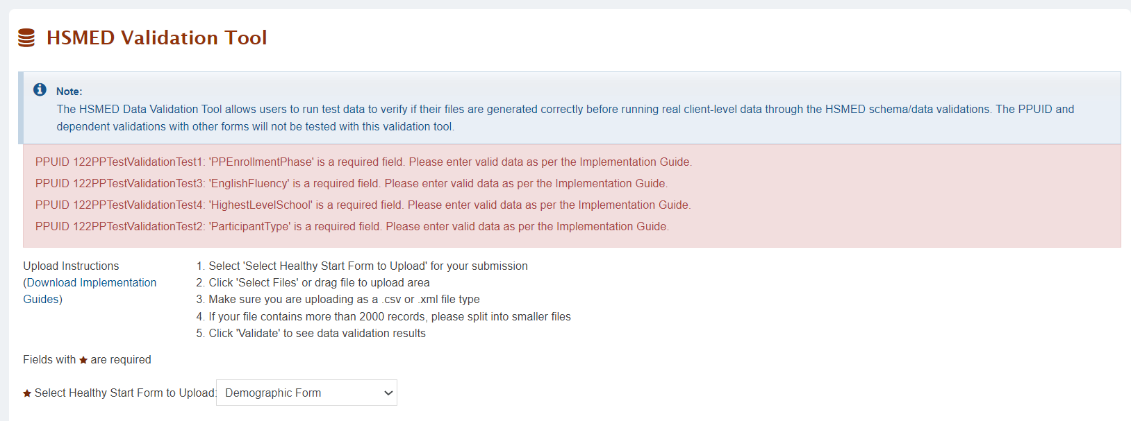
Validating Client-Level Data (cont.)
If your file does not meet schema requirements (required fields, allowed values, allowed occurrences), schema errors will be displayed on the Upload File page.
Click “Download Implementation Guides” to download a copy of the requirements and data validations for each element
Notes:
When you click validate, your file will undergo a quick schema validation. If your file does not follow schema requirements, including required fields, allowed values, and allowed number of occurrences, then schema errors will be shown in red on the upload file page.
To view requirements for each of the data elements, you can click “Download Implementation guides” to download a copy of the most current implementation guides.

Slide 15
Schema Validations
The system will show schema validation errors on the Upload File page if the uploaded file has any of the following issues when using the HSMED Validation Tool.
Schema validations in XML files | Schema validations in CSV files
Blank node in the XML file | Special Char “|” in CSV file
Incorrect/Missing XML file’s beginning/ending tags (root nodes) | Duplicate, Incorrect or blank element header in uploaded CSV file
Incorrect element name | Missing header in uploaded CSV file
The element name is missing in XML file | Special characters (,), (&), (<) present in CSV file.
Incorrect capitalization of header in CSV/XML file | Incorrect capitalization of header in CSV/XML file
Invalid values for an element | Invalid values for an element
Missing value for required field | Missing value for required field
Incorrect Date in Date elements | Incorrect Date in Date elements
Notes:
Now let’s talk about the schema validations that will display on HSMED Validation Tool page if the uploaded file has the errors.
For the XML files that will be uploaded using the validation tool, schema validations will occur if any of the following scenarios occurs in file:
Blank node in the XML file
Incorrect/Missing XML file’s beginning/ending tags (root nodes)
Incorrect element name
The element name is missing in XML file
Incorrect capitalization of header in CSV/XML file
Invalid values for an element
Missing value for required field
Incorrect Date in Date elements
For the CSV files that will be uploaded using the validation tool, schema validations will occur if any of the following scenarios occurs in file:
Special Char “|” in CSV file
Duplicate, Incorrect or blank element header in uploaded CSV file
Missing header in uploaded CSV file
Special characters (,), (&), (<) present in CSV file.
Incorrect capitalization of header in CSV/XML file
Invalid values for an element
Missing value for required field
Incorrect Date in Date elements

Slide 16
HSMED Validation Tool (cont.)
After a file passes schema check, a success message in a green box will appear on the top of the HSMED Validation Tool page indicating the file has successfully passed schema validation and data validations (excluding the PPUID and other forms dependent data validations).
Notes:
If your file passes schema check, a success message in a green box will appear on the top of the HSMED Validation Tool page indicating that the file has successfully passed schema validation and data validations (excluding the PPUID and other forms dependent data validations).
You can update this file with a valid ORG ID to upload successfully in HSMED system using “Upload file” page later.
You are welcome to leave the page at this time and work on other reports or other business, as needed.

Slide 17
Data Validation Report
If the file passes schema check but has data validations, the system will redirect you to the Data Validation Report page.
On the Data Validation Report page, a list of the data validations found in the uploaded file will be displayed.
Notes:
If the file passes schema check but have data validations, the system will redirect you to the Data Validation Report page.
Let’s review the Data Validation Report page before we move on to data validations. This page provides a list of the data validations found in the uploaded file and displays the following column details:
PPUID
Validation Type
Element Name
Message

Slide 18
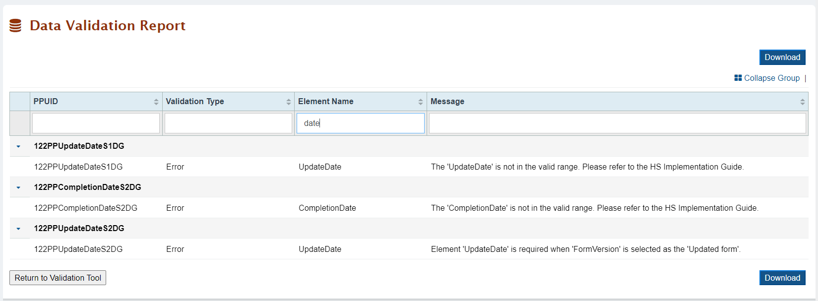
Data Validation Report (cont.)
Validations are grouped by PPUID, showing the PPUID with the data issue, the validation type, the element name, and a message describing the issue.
Validations can be filtered by typing in the fields directly below the column headers or by using the search function.
Notes:
On the validation report page, validations are grouped by PPUID and show the PPUID in which the data issue is present.
Each validation will also show the validation type (like error, warning, or alert) and a message regarding the issue present in the data.
Validations can be filtered by typing in the fields directly below the column headers or searched using the search function.

Slide 19
Data Validations
Errors: All errors must be resolved before the report can be successfully accepted.
Warnings: Users must review and, if appropriate, resolve their warnings. Users must enter a justification comment in the CSV or XML file, and reupload to the system and resolve the warning(s).
Alerts: A report can be submitted with alerts. Users do not need to enter comments to explain the data that caused the alert. These may be present even when data is valid and can also be considered as reminders to grantees about key data elements.
Notes:
Now let’s talk about the data validation checks that you might see when uploading your files.
Errors are major issues with the data that must be resolved before the report can be successfully uploaded.
Warnings are also major issues with the data, however MCHB has provided an opportunity for grantees to provide justifications for these data issues rather than requiring grantees to correct the data. Users must either correct their data or enter a justification comment in the appropriate Warning Comment field and then reupload their file to the system and resolve any warnings.
Alerts are minor data issues that highlight key data elements that MCHB has prioritized. Alerts may show even when the data submitted is correct. They can be considered reminders for grantees to review key data elements for accuracy and completeness. Files with only alerts have been successfully submitted using HSMED validation tool, and do not need to be reuploaded with changes. Users are also not required to submit comments or justifications to explain the data that caused the alert.
Validation checks performed on data elements are described in the Implementation Guides (available from the Healthy Start EPIC website and on the HSMED Validation Tool page).

Slide 20
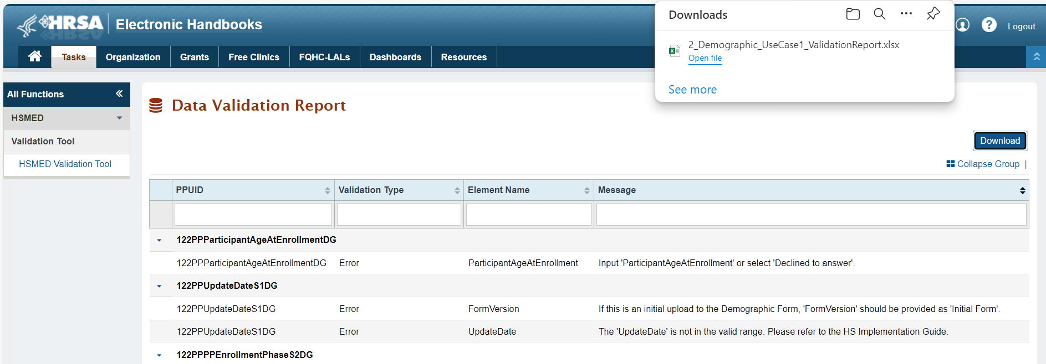
Data Validation Report – Data Download
Download button will be available on Top and Bottom of the Data Validation Report page.
Click “Download” to download the validation report with the list of all data validations for the file. The downloaded file will save in the Downloads folder of your computer.
Notes:
Now let’s talk on how data can be downloaded from the Data Validation Report page?
Download button will be available on Top and Bottom of the Data Validation Report page.
You can click on “Download” button to download the validation report with the list of all data validations for the uploaded file. The downloaded file will save in the Downloads folder of your computer.

Slide 21
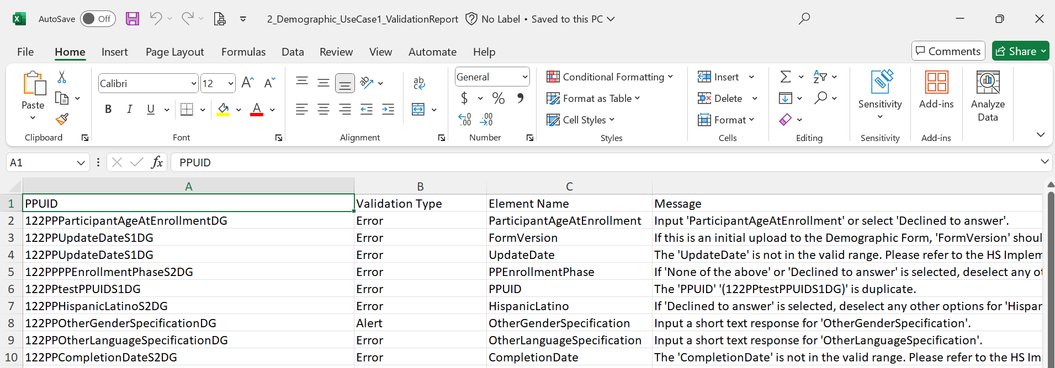
Data Validation Report – Data Download
The downloaded Excel will display PPUID, Validation Type, Element Name, Message columns same as what displays on Data Validation Report page.
Notes:
On the downloaded excel, you will see PPUID, Validation Type, Element Name, Message column details same as what displays on Data Validation Report page. This excel helps the grantee to save the list of validation errors on their test file to work upon it, as needed.

Slide 22
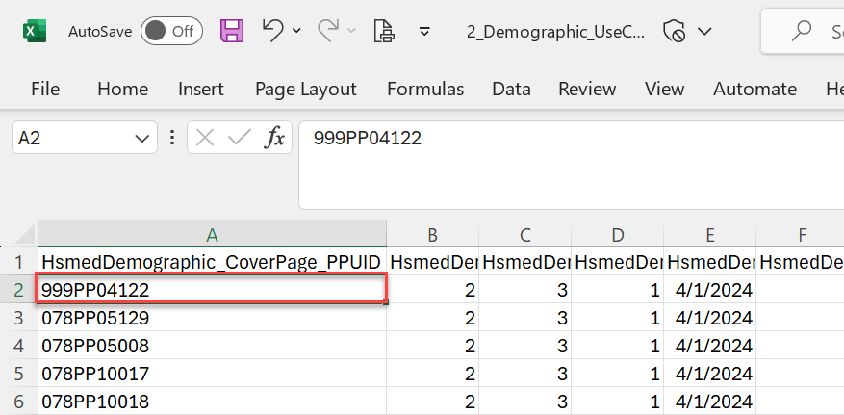
HSMED Validation Tool- Exceptions
The PPUID and dependent validations with other forms will not be validated with this validation tool.
Example 1: If a PPUID with an invalid ORG ID is entered in the file and uploaded on HSMED Validation Tool page, the file will not give any data validation error for the PPUID element and error message “The PPUID has an invalid Org Id.” will not display.
Notes:
The one important point to note here is that the PPUID and dependent validations with other forms will not be validated using the HSMED Validation Tool.
For example, If a PPUID with an invalid ORG ID is entered in the file and uploaded on HSMED Validation Tool page, the file will not give any data validation error for the PPUID element and error message like “The PPUID has an invalid Org Id.” will not display.

Slide 23
HSMED Validation Tool- Exceptions (Cont.)
Example 2: Below are some examples of dependent validations that will not be validated using the validation tool as the data of files that are uploaded using the HSMED validation tool are not saved in HSMED system.
Form Name | Element Name | Data Validation
Background Form | MoreChildrenDesired | [If Participant type in demographic form = CM/CC participant, and this field is blank] Element 'MoreChildrenDesired' is missing.
Prenatal Form | OtherUpdateDate | [IF update type is “Pregnancy Ends”: NewPregnancyDate allowed, OtherUpdateDate must be blank] 'OtherUpdateDate' cannot have a value since 'UpdateType' is selected as 'Pregnancy Ends'.
Parent/Child Form | ReceivedPostpartumCare | [If Participant type in demographic form = CM/CC particpant and Sex in Demographic form is 'Female' and ReceivedPostpartumCare is missing] Element 'ReceivedPostpartumCare' is required since 'ParticipantType' is a 'CM/CC participant' and 'Sex' is 'Female'.
Notes:
Here are some examples of dependent validations that will not be validated using the validation tool as the data of files that are uploaded using the HSMED validation tool are not saved in HSMED system.
For example, MoreChildrenDesired element of background form should ideally display the validation on upload if a Participant type in demographic form is equal to CM/CC participant, and MoreChildrenDesired element is blank.
But you cannot validate this when the file is uploaded using the validation tool as the data for demographic form will not be available in HSMED system. The HSMED Validation Tool doesn’t save data in the HSMED system for any uploads.

Slide 24
Correcting Submitted Data
To correct data, you have already submitted to HSMED Validation Tool, upload your corrected file to HSMED Validation Tool using the same process previously discussed. Please note the following:
Correct the file data to resolve the data validations.
Leave all fields that were previously correct as is.
The HSMED Validation Tool page will not save any data from previous or current uploads.
The Implementation Guides explain and demonstrate in detail what types of values are compliant for each field in the CSV/XML. They also provide examples of how those fields should look within the CSV/XML.
Notes:
To correct data, you have already submitted to HSMED, upload your corrected file to HSMED using the same upload process previously discussed. There are a couple of things to keep in mind when correcting your data.
Correct the file data to resolve the data validations.
Leave all fields that were previously correct as is.
The HSMED Validation Tool page will not save any data from previous or current uploads.
You can refer to the Implementation Guides that explain and demonstrate in detail what types of values are compliant for each field in the CSV or XML files. They also provide examples of how those fields should look within the CSV or XML files.

Slide 25
Technical Assistance and Support
For issues regarding EHBs, please contact the EHBs helpline: 877-Go4-HRSA/877-464-4772
For questions specific to use of HSMED, please send an email to: HealthyStartData@hrsa.gov and use the subject line: “Technical Support Request for HSMED”
For questions regarding MCHB policy and SOPs, please send questions to: HealthyStartData@hrsa.gov
Notes:
If you run into any problems or issues while submitting your reports, please refer your questions to the technical support options listed on this slide.
For issues regarding EHBs, please contact the EHBs hotline. For example, if you’re having trouble with registration, logging into your account, or associating your account with an organization, those would be considered EHBs general questions.
For issues regarding the HSMED system, please send an email to: HealthyStartData@hrsa.gov and use the subject line: “Technical Support Request for HSMED”. Please remember to include the correct subject line, as it will ensure that your question is redirected in a timely fashion to the people who are able to provide the best support. Please include as much information as possible, including browser used, screenshots, and any files that may be having issues.
Questions regarding MCHB policy, best practices, and standard operating procedures (SOPs) should be sent to: HealthyStartData@hrsa.gov
For example, if you have questions about what type of data you should be reporting, completeness or data quality, update types, etc.

