Slide 1
Revised Healthy Start Data Collection Forms
June 2024 Training
Lina Barrett, MPH
Public Health Analyst, DHSPS/Data and Evaluation Branch
Maternal and Child Health Bureau (MCHB)

Slide 2
Training Agenda
Overview
Form Layout
Initial Screening Process
Form-Specific Instructions
Notes for Data Managers

Slide 3
Data Collection Overview
Purpose & Screening Guidelines

Slide 4
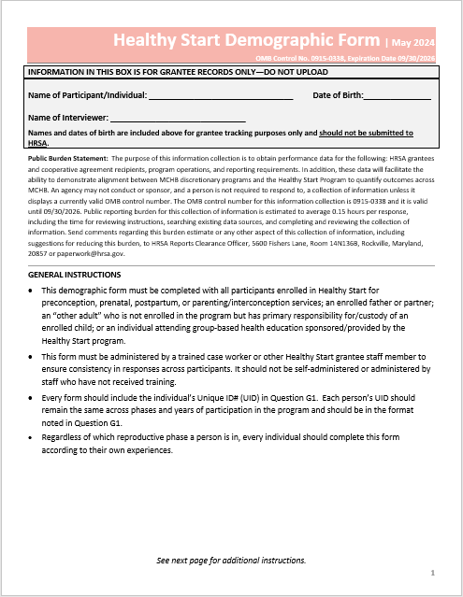
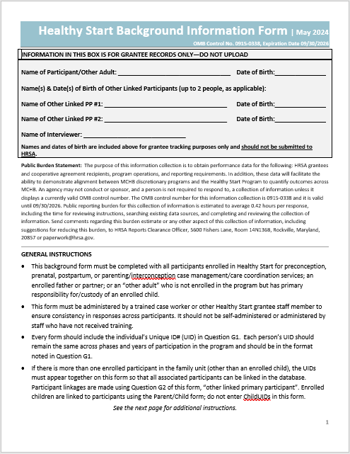
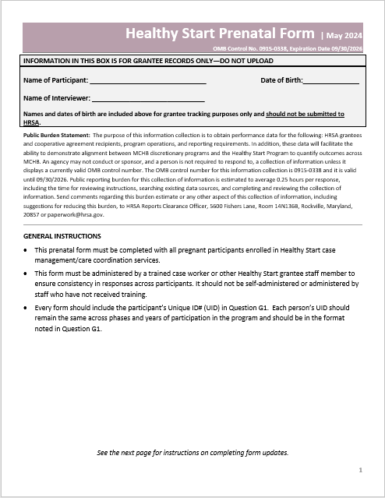
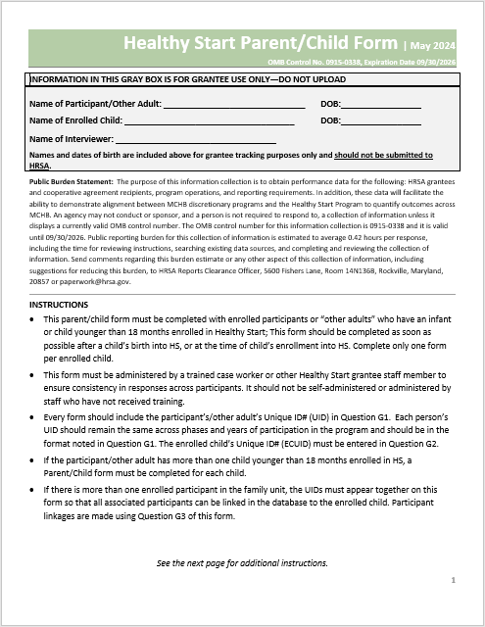
2024 HS Data Collection Forms – Overview
Demographic – 9 Qs
Background – 25 Qs
Prenatal – 15 Qs
Parent/Child – 22 Qs
Purpose:
To track changes in participant health behaviors, health status, and outcomes throughout their enrollment in Healthy Start

Slide 5
Screening Guidelines
Collect data using the forms
Do not alter the forms or screening procedure
Screen every participant
Interview – Must be completed with the participant
Participant self-report

Slide 6
Form Layout
Instructions, Topic Headers, Question Format, Form Versions

Slide 7
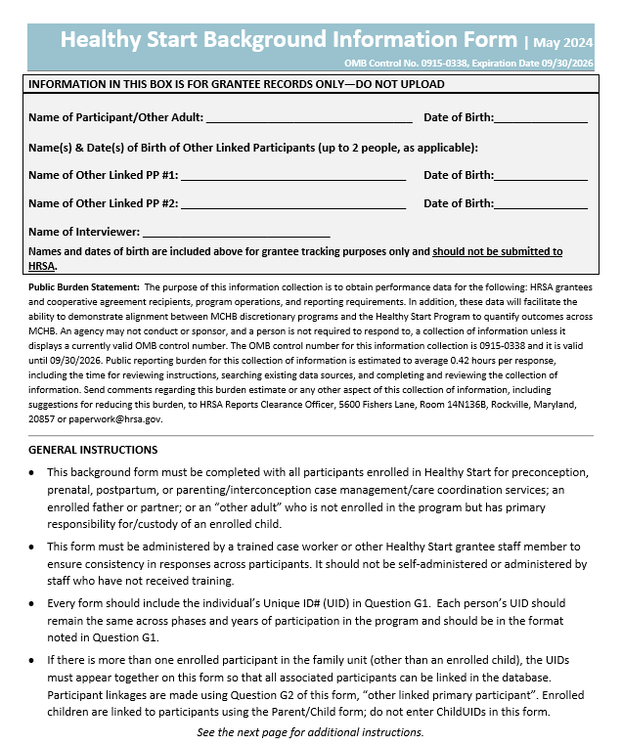
Form Instructions – Pg. 1
Participant Identifiers
Not shared with HRSA
Public Burden Statement
Read to participant
General Instructions
Who to screen
Required training
Participant ID
Linking participants
1
2
3

Slide 8
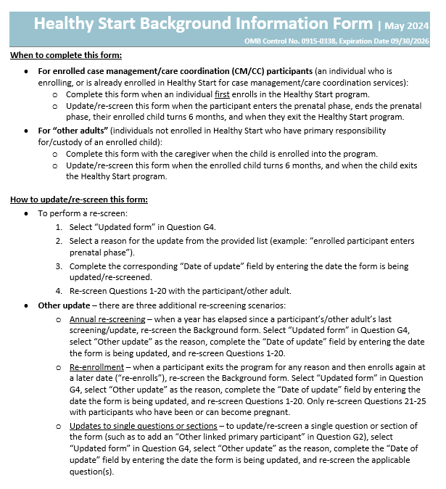
Form Instructions – Pg. 2
When to screen
How to update

Slide 9
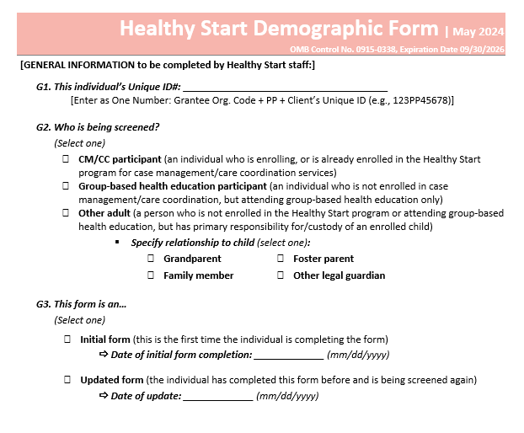
General Information – Pg. 3
Participant’s ID
Contextual info
Participant Type (CM/CC, group-based, “Other adult”)
Enrollment date
Other linked participants/adults
Form Version
Initial or Update
*This section can be prepared ahead… BUT do not enter dates until form is completed with the participant

Slide 10
Topic Headers
Questions are organized by topics
Headers include short intros to each topic

Slide 11
Question Format
Question #
Question
# of responses allowed
Response options

Slide 12
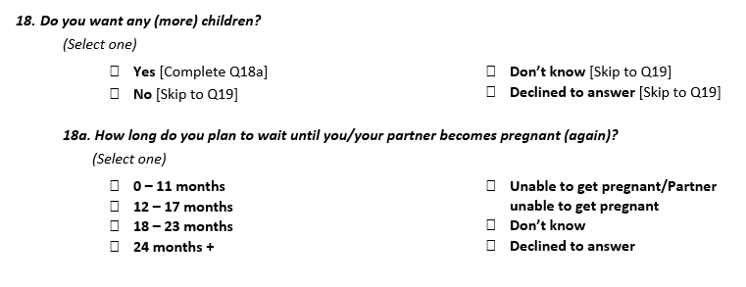
Question Skip Logic

Slide 13
Updating a Form
First screening
Never change
Follow-up screenings
When updating, you must select a reason and enter the date
*Enter the date you screened the participant

Slide 14
Initial Screening Process
Screening Flow Charts by Participant Type

Slide 15
Participant Types
GBE – Group-based health and parenting education
Attends group-based health education classes/meetings/series’
Not enrolled in CM/CC, no assigned CM/CHW
CM/CC – Case management/Care Coordination
Enrolled in case management/care coordination services
Receives 1-on-1 visits with a CM/CHW
Other Adult
Primary responsibility for/custody of an enrolled child
Not enrolled in CM/CC, not attending group-based classes/meetings/series’

Slide 16
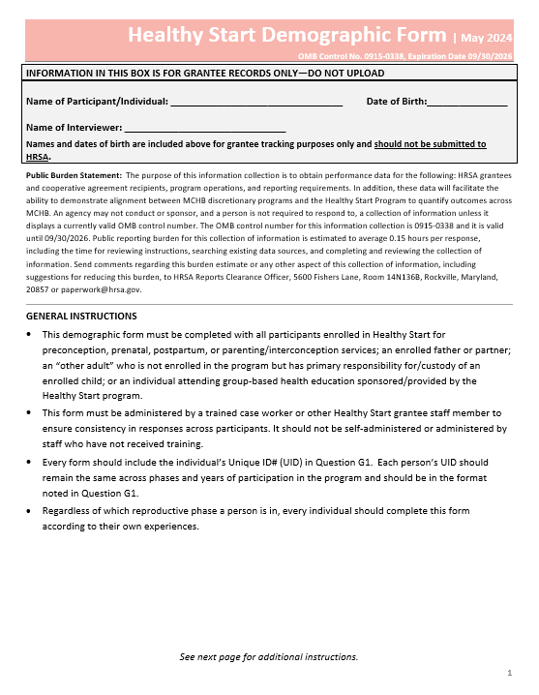
GBE Participant - Initial Screening
GBE Participant
Demographic Form

Slide 17
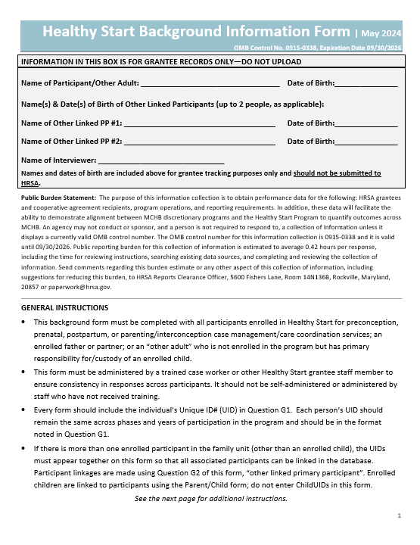
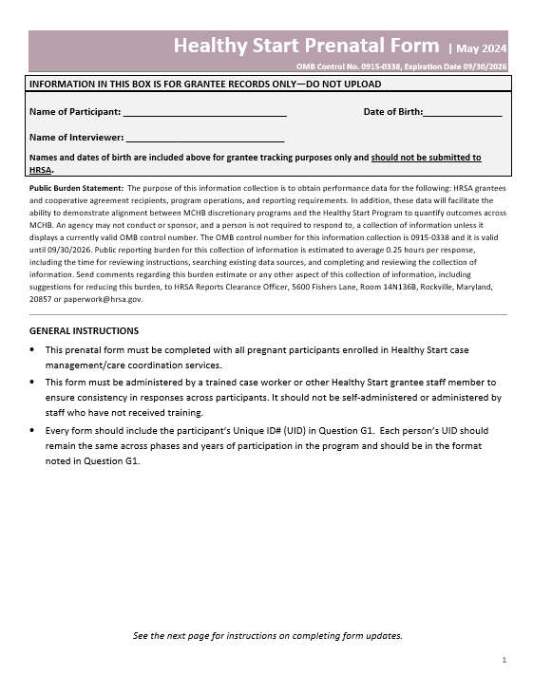
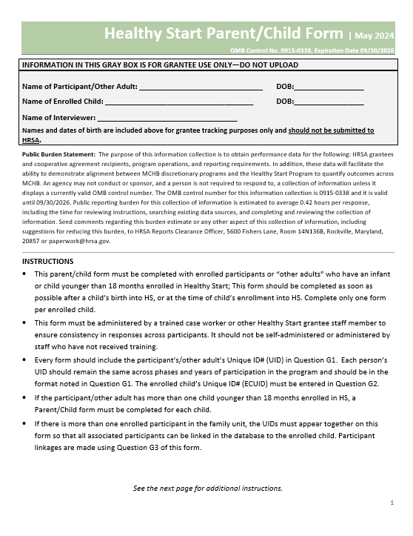
CM/CC Participant - Initial Screening
Demographic Form
Background Form
CM/CC Participant
Prenatal Form
Parent/Child Form
Currently pregnant?
Parenting a child under 18 months?
Yes
No
Yes
Initial screening is complete
No

Slide 18
Other Adult - Initial Screening
“Other Adult”
Demographic Form
Background Form
Parent/Child Form

Slide 19
Conducting the Interview
Conversational
Participant self-report
Use screening to determine health education, resources, and referrals

Slide 20
Form-Specific Instructions

Slide 21
Demographic Form
All Participants & Other Adults

Slide 22
Demographic Form - Overview
Complete form with all participants
Screen GBE, CM/CC, and Other Adults
1 form per participant

Slide 23
Demographic Form – When to Complete
Who to Screen
All participants and caregivers of enrolled children
When to Screen
Other Adult – When child is enrolled
GBE – When individual meets participation criteria
CM/CC – At enrollment

Slide 24
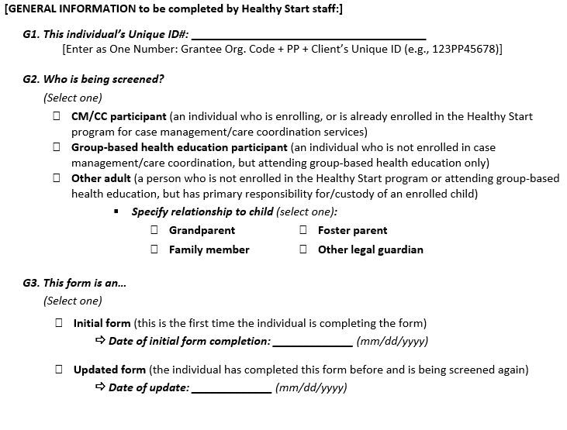
Demographic Form – General Information (Pg. 3)
G1 – Participant’s ID
G2 – Participant Type
G3 – Form Version
*When initial screening is complete, enter Completion Date.

Slide 25
Demographic Form – Questions (Pg. 4 – 5)
Q1 – Reproductive phase at enrollment
Q2 – Age at enrollment
Q3 & Q4 – Gender Identity & Sex
Q5 & Q6 – Ethnicity & Race
Q7 & Q8 – Primary Language & English Fluency
Q9 – Education Level

Slide 26
Demographic Form – Updates/Re-screening
Update/re-screen when:
Participant Type changes (G2)
Response(s) to Question 3-9 change
*Never change Q1 (“reproductive phase”) or Q2 (“age”)

Slide 27
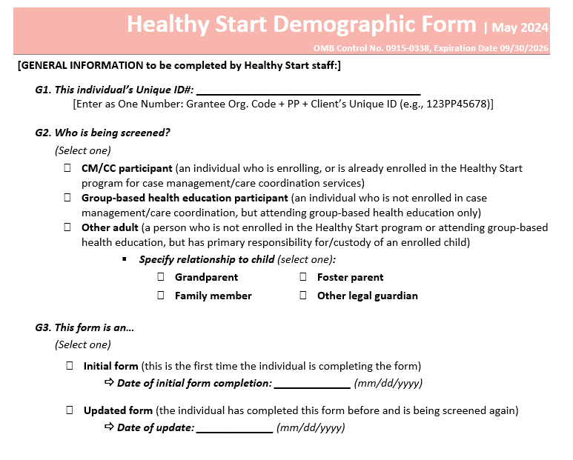
Demographic Form – Update Examples
Example: GBE participant decides to enroll in CM/CC
001PP1234ABC
Participant Type change:
Select “Updated Form” in G3
Complete “Date of update” field in G3
Update response to G2
05/25/2024
06/05/2024

Slide 28
Demographic Form – Update Examples
Example: Participant graduates high school
05/25/2024
Single question change:
Select “Updated Form” in G3.
Complete “Date of update” field in G3
Update response to Q9 (education).
06/05/2024

Slide 29
Background Form
All CM/CC Participants & Other Adults

Slide 30
Background Form – Overview
Complete form with all CM/CC participants and Other Adults
Screen preconceptive, pregnant, parenting participants
Screen CM/CC enrolled fathers/partners
Screen parents/caregivers of enrolled children (Other Adults)
1 form per participant/Other Adult

Slide 31
Background Form – When to Complete
Who to Screen
All CM/CC participants
At enrollment
Other Adults
When to Screen
Update/re-screen:
Becomes pregnant
No longer pregnant
Enrolled child turns 6m
Exits program

Slide 32
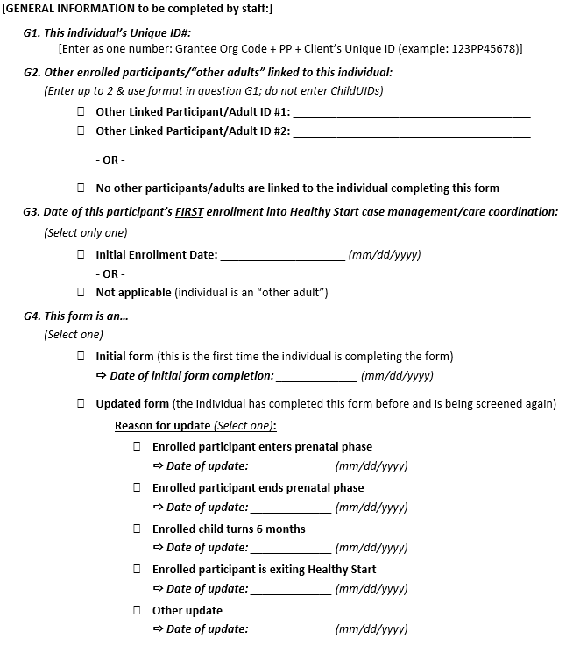
Background Form – General Information (Pg. 3)
G1 – Participant’s ID
G2 – Participant Linkages
G3 – Enrollment Date
G4 – Form Version
*When initial screening is complete, enter Completion Date.

Slide 33
Background Form – Linking Participants (G2)
Question G2 – link parents/caregivers/co-parents
Ex. – an enrolled pregnant pt and their enrolled partner
To link participants:
Check “Other Linked Participant/Adult” and add the other person’s PPUID
*Only link parents/caregivers – no child IDs

Slide 34
Background Form – Enrollment Date (G3)
CM/CC participants – Enter date participant first enrolled in Healthy Start (format mm/dd/yyyy”)
Other Adults – Select “Not applicable”

Slide 35
Background Form – Topics/Questions (Pg. 4 – 13)
CM/CC Participants and Other Adults
Participant General Information
Participant Health Care
Personal Well-Being
CM/CC Participants
Reproductive Health
CM/CC Pts who are/can become pregnant
Pregnancy and Childbirth History
CM/CC Pts who had a live birth
Previous Births

Slide 36
Background Form – Update Examples
Reproductive Phase Change & Exit
CM/CC Participants:
Update/re-screen when:
Becomes pregnant
Is no longer pregnant
Their enrolled child turns 6 months
Exits the program
Other Adults:
Update/re-screen when:
Their enrolled child turns 6 months
Their child exits the program

Slide 37
Background Form – Update Examples
Example: Participant becomes pregnant
Reproductive phase change:
Select “Updated form” in G4.
Select reason for update (“enrolled participant enters prenatal phase”)
Complete “Date of update” field by entering the date the form is being updated/re-screened
Re-screen Questions 1-20 with the participant/other adult.
06/05/2024
*Enter the date the form is updated

Slide 38
Background Form – Tracking Updates
Track update dates in “Date of update” field
Example:
06/05/2024
A pregnant participant enrolls and completes initial Background form on 6/5/2024
02/03/2026
Pt gives birth, completes “Ends Prenatal Phase” update on 8/23/2024
08/23/2024
Pt’s child turns 6m, completes “Enrolled child turns 6 months” update on 3/1/2025
03/01/2025
If participant becomes pregnant, reset update dates
Pt notifies case manager they are pregnant, completes “Enters Prenatal Phase” update on 2/3/2026

Slide 39
Background Form – Other Updates
Three Scenarios for “Other Updates”:
Annual Re-screening – no update to the form for a full year
Re-enrollment – participant exited and is enrolling again
Updates to single questions or sections – reproductive phase hasn’t changed, but program wants to update a question or section of the form

Slide 40
Background Form – Other Update
Annual Re-screen
Re-screen Questions 1-20
Re-Enrollment
Re-screen Questions 1-20
Single Question/Section Update
Re-screen single question or section, as applicable
Re-screen Questions 21-25 with participants who can become pregnant

Slide 41
Prenatal Form
All Pregnant CM/CC Participants

Slide 42
Prenatal Form – Overview
Complete form with all pregnant participants
1 form per pregnancy

Slide 43
Prenatal Form – When to Complete
Who to Screen
All CM/CC participants who are pregnant
When to Screen
At enrollment
Pt becomes pregnant
Pt gives birth or is no longer pregnant (complete Post-Pregnancy Follow-up)
Update/re-screen if:
Questions 1-5 unknown during initial screen
Post-Pregnancy Questions 1-7 were unknown during initial screen

Slide 44
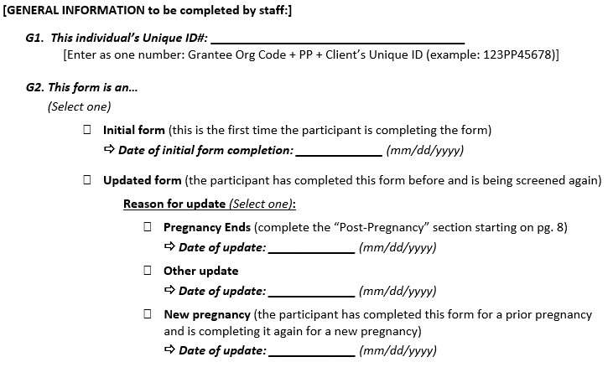
Prenatal Form – General Information (Pg. 3)
G1 – Participant’s ID
G2 – Form Version
*When initial screening is complete, enter Completion Date.

Slide 45
Prenatal Form – Topics/Questions (Pg. 4 – 6)
Completed while participant is pregnant:
Pregnancy and Health
Home Life

Slide 46
Post-Pregnancy Follow-up – (Pg. 7 – 9)
Completed after participant gives birth or is no longer pregnant:
Q1 – Initial Outcomes of Pregnancy
Q2 – Delivery Type
Q3 – Maternal Morbidity
Q4 – Child ID(s)
Q5 – Neonatal Death (Death of a live infant within 27 days of delivery)
Q6 – Maternal Death (Death of participant during pregnancy or within 1 year of the end of the pregnancy)
Q7 – Outcome Sources

Slide 47
Prenatal Form – Update Examples
Example: Participant gives birth
Pregnancy Ends update:
Select “Updated form” in G2
Select “Pregnancy Ends” as the reason for update
Complete “Date of update” field by entering the date the form is being updated
Complete the “Post-Pregnancy Follow-up” section starting on page 7
06/05/2024
*Enter the date the form is updated
*Update the Background Form as well

Slide 48
Prenatal Form – Other Updates
Update Q1 – Q5 if they were unknown at the time of initial screening:
Select “Updated form” in G2
Select “Other update” as the reason for update
Complete “Date of update” field by entering the date the form is being updated
Re-screen Questions 1 – 5, as needed
06/05/2024
*Enter the date the form is updated

Slide 49
Prenatal Form – Other Updates
Update Post-Pregnancy Follow-up Q1 – Q7 if they were unknown at the time of initial screening:
Select “Updated form” in G2
Select “Other update” as the reason for update
Complete “Date of update” field by entering the date the form is being updated
Re-screen Questions 1 – 7 of the Post-Pregnancy Follow-up section, as needed
06/05/2024
*Enter the date the form is updated
*Use this method to record neonatal loss or maternal loss that occurs after completion of the Post-Pregnancy Follow-up

Slide 50
Prenatal Form – Pregnancy Ends Update
If participant already completed a prenatal form, and becomes pregnant again:
Select “Updated form” in G2
Select “New pregnancy”
Complete “Date of update” field by entering the date the form is being updated
Screen Questions 1 – 7 of the Prenatal Form
06/05/2024
*Enter the date the form is updated
*Complete the Post-Pregnancy Section as a “Pregnancy Ends” update when the participant gives birth or is no longer pregnant. Update the Background form as well.

Slide 51
Prenatal Form – Tracking Updates
Track update dates in “Date of update” field
Example:
06/05/2024
A pregnant participant completed initial form on 6/5/2024
Pt gives birth, then completes “Pregnancy Ends” update on 8/20/2024
08/20/2024
Case manager updates the Post-Pregnancy Follow-up Section Q4 on 10/23/2024 because child’s ID wasn’t created at the time of initial screening of the Post-Pregnancy Section
10/23/2024
07/24/2025
If participant becomes pregnant, reset update dates
Pt notifies case manager they are pregnant, completes “New pregnancy” update on 7/24/2025

Slide 52
Parent/Child Form
All Participants & Other Adults with an Enrolled Child

Slide 53
Parent/Child Form – Overview
Complete with parent/caregiver of all enrolled children
1 form per child
If both parents are enrolled, either can complete the form
Recommend follow-up with birthing parent to complete Question 20 (postpartum visit) and Question 21 (tobacco/nicotine use during pregnancy)

Slide 54
Parent/Child Form
Who to Screen
All CM/CC pts with enrolled children
When to Screen
At enrollment
All caregivers of enrolled children (“Other adults”)
When child is born
If pt is pregnant at the time of enrollment

Slide 55
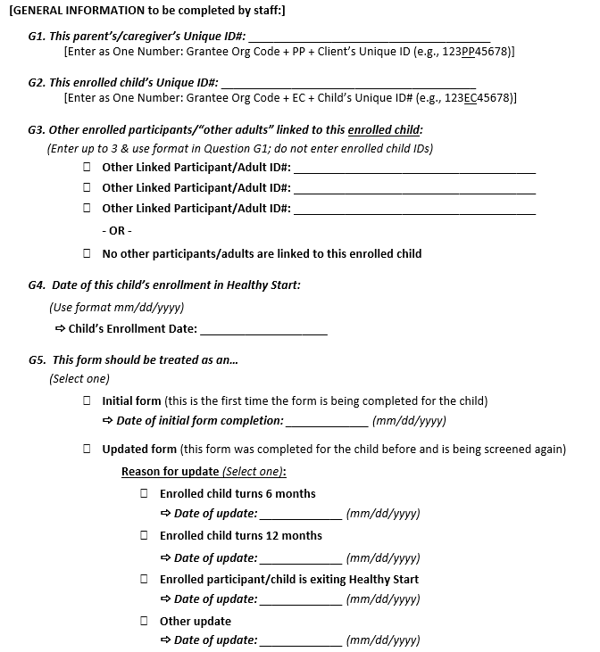
Parent/Child Form – General Information (Pg. 3)
G1 – Participant’s ID
G2 – Child’s ID
G3 – Participant/Caregiver Linkages to Child
G4 – Child’s Enrollment Date
G5 – Form Version
*When initial screening is complete, enter Completion Date.

Slide 56
Parent/Child Form – Topics/Questions (Pg. 4 – 9)
The Child: Setting the Stage (demographics)
Infant Health at Birth
Infant Health Care
Infant Feeding
Infant Sleep

Slide 57
Parent/Child Form – Topics/Questions (Pg. 10)
Completed with the parent who gave birth (only CM/CC)
Pregnancy Health
Q20 – Postpartum Visit
Q21 – Tobacco/Nicotine Use in Last 3 Months of Pregnancy

Slide 58
Parent/Child Form – Topics/Questions (Pg. 11)
Completed only if an enrolled child passes away (Other update):
Infant/Child Follow-up
Q22 – Infant/child age range

Slide 59
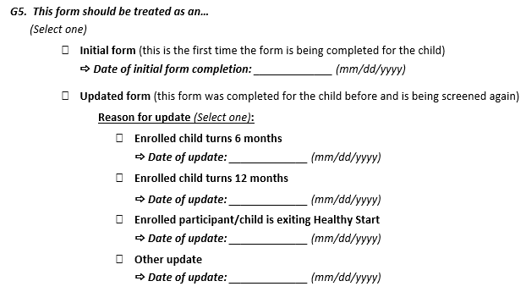
Parent/Child Form – Update Examples
Age Updates & Exit
When a child turns 6m, 12m, or exits:
Select “Updated form” in G5
Select a reason for the update (example: “enrolled child turns 6 months”)
Complete “Date of update” field
Re-screen Questions 9-19 with the participant/other adult. Participants who were enrolled in HS while pregnant with this child should also re-screen questions 20 and 21
06/05/2024
*Enter the date the form is updated
*Update the parent/caregiver’s Background Form when child turns 6 months and when child exits the program

Slide 60
Parent/Child Form – Other Updates
Updates to Single Questions/Sections
Select “Updated form” in G5
Select a “Other update”
Complete “Date of update” field
Re-screen Question or Section. To record a child loss, only complete Q22
06/05/2024

Slide 61
Parent/Child Form – Tracking Updates
Track update dates in “Date of update” field
Example:
A participant completes initial form on 6/5/2024 for their child
06/05/2024
Child turns 6m, then participant completes “Enrolled child turns 6 months” update on 8/10/2024
08/10/2024
Child turns 12m, then participant completes “Enrolled child turns 12 months” update on 2/03/2025
02/03/2025
Case manager updates a question on 03/16/2025
08/20/2025
Child turns 18 months, completes “Enrolled child is exiting Healthy Start” update on 8/20/2025
03/16/2025

Slide 62
Notes for Data Managers

Slide 63
Notes for Data Managers – HSMED Guidelines
Required Data Elements
Some data elements are required
Enrollment Date
Completion Date
Some are conditionally required
“Previous Births” section if participant had a previous live birth (Background Form)
Resources:
HSMED Implementation Guides

Slide 64
Notes for Data Managers – HSMED Guidelines
Must have a completed form uploaded to count a participant
Participants who decline screening can be counted by selecting “Declined to answer”

Slide 65
Notes for Data Managers – Unduplicated Counts
Participant Type Changes
Participant moves from GBE to CM/CC – remove from GBE count and count as a CM/CC participant for the reporting year.
Participant moves from CM/CC to GBE – continue counting under CM/CC for the reporting year.
* A participant can only be counted once in the total count of 700 participants per year.

Slide 66
Notes for Data Managers – Correcting a Form
Only staff who upload data to the HSMED should use this checkbox
Only upload a correction if incorrect data has been saved to the HSMED
Upload a correction before uploading additional screenings for a participant (correction must overwrite incorrect form)
Check your files to make sure you’re not accidentally uploading a correction; it affects how data is stored and can overwrite files you intend to save
We recommend not programming the correction checkbox into your system – you should manually enter a value for the Correction data element when you need to use it

Slide 67
HSMED Upload Training
6/25 from 2 – 3:00pm ET
Registration link coming soon
Recorded and posted to the HealthyStart-tasc.org website
*Data collection forms are available at HealthyStart-tasc.org (Implementation tab)!

Slide 68
DHSPS Data Collection and Reporting Assistance:
HealthyStartData@hrsa.gov

