Slide 1
Moving On: Supporting the Transition From the Electronic Screening Tool
Highlighting data system options to support Healthy Start program implementation

Slide 2
Speakers
Healthy Start EPIC Center Help Desk Team
Amanda Baker
Maria Walawender
Division of Healthy Start and Perinatal Services
Chris Lim | Project Officer
Notes:
Amanda Baker is a consultant with JSI who serves as the Technical Assistance Coordinator for HS grantees in FL and GA and is also a member of the EPIC Center Training Team. Maria Walawender is a project associate at the Healthy Start EPIC Center. She coordinates the community training program, updates the EPIC Center website and social media applications. Amanda and Maria are both core members of the EPIC Center Help Desk Team focused on working with grantees currently using the Electronic Screening Tool among many other things
Christopher Lim, Division of Healthy Start and Perinatal Services

Slide 3
Speakers
Westside Healthy Start | Access Community Health Network
Timika Anderson Project Director
Dara Gray Program Manager
Lindsay Zeman Evaluator
Sarah Pylant Data Manager
Notes:
Westside Healthy Start | Access Community Health Network Timika Anderson-Reeves is has worked in the Maternal Child Health community for 15 years and has committed her life's work to improve social issues that influence the health outcomes of mothers, babies, and families in urban communities. Timika currently serves as Westside Healthy Start Project Director and MCH Program Manager for Partnership and Outreach Services at Access Community Health Network, an integrated network of over 30 community health centers serving medically underserved communities in the Chicago metropolitan area. A fun fact about Timika is that she use to be a Hammer/Weight Thrower in College!
Dara M. Gray is a licensed clinical social worker (LCSW) and currently serves as a Maternal and Child Health (MCH) Program Manager at Access Community Health Network (ACCESS) in Chicago, Illinois. Dara provides leadership to a team of MCH High Risk Case Managers and Breastfeeding Counselor for the Westside Healthy Start program. Sarah Plylant earned her Master of Public Health degree this past May and began working as a data manager for the Westside Healthy Start program at ACCESS in June. Lindsay Zeman received a Master of Public Health degree in June 2015 and started working as the Evaluator for Westside Healthy Start In June 2017. A fun fact about Lindsay is that her introduction into Maternal and Child Health field was during her time as Peace Corps Volunteer in Burkina Faso, West Africa.

Slide 4
Speakers
California Border Healthy Start
Lisa Bain | Project Director
San Antonio Healthy Start
James Counts | Social Services Manager
Notes:
Lisa Bain is the Deputy Director for PCI’s US & Border Programs, and serves as the Program Manager for California Border Healthy Start. Lisa holds a Master’s Degree in Public Health from UCLA and a BA in International Politics from UC Santa Cruz. Her experience includes work as an HIV focused Peace Corps volunteer in South Africa, work with diverse population for reproductive health, CHW training, and chronic disease prevention, and training as a childbirth educator, Community Emergency Response Team (CERT) member, Certified Enrollment Counselor for Covered California, and Parents as Teacher (PAT) and Healthy Families America (HFA) home visitor & supervisor trainings.
James A. Counts has worked as Social Service Manager for San Antonio Healthy Start program since Nov 2014. Married for 26 years to Tanya Counts, who has a Master’s Degree in Non-Profit Management, James has a Master’s degree in Conflict resolution. He has two kids; a 22 year old daughter, Aisha Counts, who has degrees in Business and Pre-Law, and a 20 year son, Jakobi Counts, who will graduate Spring 2019 in Business Finance.

Slide 5
Today’s Objectives
Understand the major functionality of some of the most commonly-used electronic data systems for Healthy Start grantees
Identify which platforms grantees are interested in learning more about, either through the discussion groups or directly from the vendor
Identify the types of questions or features grantees would like to explore further in selecting an electronic data system

Slide 6
Background

Slide 7
Why now?
HS EPIC Electronic Screening Tool (aka Survey Gizmo) will be phased out and shut down on March 31, 2019.
New funding cycle
Opportunity for HS programs to learn from current users about their experience using systems
Notes:
Intended to be an interim solution
Opportunity to write different system into new grant application

Slide 8
Platform Selection Process
Platforms featured today selected based on grantee feedback.
CoIIN survey to understand platforms in use
Phone interviews with current EST users to gauge interest in various platforms
Inclusion in this webinar is NOT an endorsement of any one platform or vendor; nor is it to be construed as a recommendation or giving any preferential treatment.
Onus remains with grantees to fully vet best vendor for their purposes.

Slide 9
Other Supports Available
Who is interested in follow up discussion groups, and for which platforms?
REDCap
ChallengerSoft
GoBeyond / WellFamily
Social Solutions | ETO or Apricot
Peer Place
Others?

Slide 10
Access Community Health Network Westside Healthy Start (WHS) & Research Electronic Data Capture (REDCap)
Timika Anderson-Reeves, Program Director
Dara Gray, Program Manager
Lindsay Zeman, Evaluation Specialist
Sarah Pylant, Data Management Specialist
October 24, 2018
Notes:
Timika to introduce the presentation and flow of the presentation.
Hello everyone. I’m Lindsay, the local evaluator for Westside Healthy Start, and I have the most day-to-day contact with REDCap so I’ll be walking you through some of the REDCap basics.

Slide 11
Outline
REDCap Overview
REDCap Project Development
Online Designer
REDCap Features
Data Entry
Reporting
HSMED Upload
Notes:
During this presentation, we’ll discuss the following:
A general overview of REDCap,
Project development,
Data entry for case managers and other Healthy Start staff,
Reporting, and
HSMED upload

Slide 12
REDCap Overview
What is REDCap?
“REDCap (Research Electronic Data Capture) is a secure web application for building and managing online surveys and databases.”
How do I get REDCap at my organization?
“REDCap software and support are available at no charge to institutions that join the REDCap Consortium.”
How do I join the REDCap Consortium?
Review infrastructure requirements (i.e. PHP web server, MySQL database server, etc.)
Review end-user license agreement between Vanderbilt University and your institution
For more information: https://projectredcap.org/ and select
Notes:
First, what is REDCap? According to the REDCap website, REDCap or Research Electronic Data Capture is a secure web application for building and managing online surveys and databases.” It was developed as “user-friendly web-based interface that was introduced to put researchers in control of their work.” Therefore, background knowledge and technical experience aren’t needed to use REDCap.
Next, how do I get REDCap at my organization? “REDCap software and support are available at no charge to institutions/non-profits that join the REDCap Consortium.” REDCap doesn’t cost anything but you will need personnel. REDCap suggests a “technical person (or team) for installing and maintaining the software, as well as an administrative person (or team) who will provide day-to-day assistance to your REDCap end-users.”
So, what is the REDCap Consortium? The consortium includes sites such as ACCESS all around the world. As a consortium member, you’ll have access to the following:
Software
Support – because it’s free support is limited.
Weekly virtual meetings to discuss new development, outstanding support issues, etc.
REDCap Community Site–It includes Q&As and discussion and his is where you’ll find most of your support.
Annual REDCapCon a face-to-face meeting
Finally, how do I join the REDCap Consortium? First, confirm with your IT department if you meet the requirements. There is a REDCap Technical Overview PDF on their website that details IT infrastructure needs. If you have the infrastructure and there is an end-user license agreement on the REDCap website. This will be between Vanderbilt University and your institution.

Slide 13
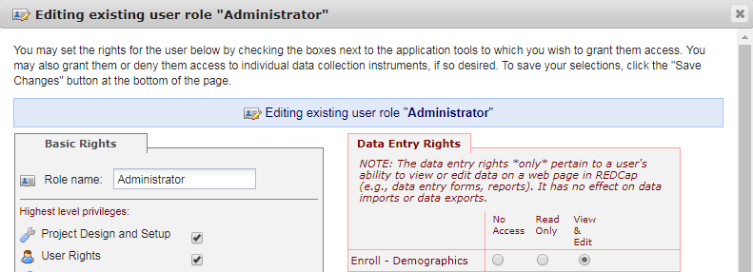
REDCap Overview - Security
“Security surrounding REDCap has nothing to do with the REDCap software itself but rather is dependent upon the IT infrastructure and environment in which REDCap has been installed.”
REDCap User Privileges
Users will only have access to created projects or projects to which they have been granted access
User Rights
Data Access Groups (DAGs)
REDCap Authentication
Auto-logout Setting
Notes:
Another question you might have is how secure is REDCap? REDCap states that “security surrounding REDCap has nothing to do with the REDCap software itself but rather is dependent upon the IT infrastructure and environment in which REDCap has been installed.” Again review, the Technical Overview PDF
REDCap does include features for added security – to which I can speak.
User Privileges/Rights- This starts with deciding who will be a part of your project because REDCap can support numerous projects. Once staff is added to the project, roles can be created and tailored within a project. For example, I’m the project administrator for WHS so I control who can or cannot see content, who can see content and not edit or be able to see content and edit it. Rights are also broken down by basic rights (access to applications) and data entry rights. You can see a snapshot of what the looks like here on the bottom right.
DAGS – DAGS or data access groups are used to segregate users and the data they enter. ACCESS uses DAGs for our subcontractors. For example, an ACCESS Case Manager is in the ACCESS DAG and they can only see other data in the ACCESS DAG. They can not see our subcontractor’s data.
REDCap Authentication- This is used to validate the identify of end-users. For our subcontractors, we use Table-based users. This is a feature built into REDCap and doesn’t require set up.
Lastly there is an auto-logout setting and this is customizable.

Slide 14
REDCap Project Development
Project Types
Survey
Traditional (i.e. WHS) – Data entry happens within the project; new records are created; structure can vary.
Longitudinal – Designed to capture the same variables multiple times over time. The REDCap longitudinal module forms are displayed in a grid.
Notes:
REDCap captures data through 3 different project types:
Survey
Traditional
Longitudinal
The ACCESS’ WHS project is a traditional project with a number of forms or instruments built for data entry which is completed by case managers and breastfeeding counselors.
ACCESS implemented REDCap for a number of reasons. I spoke with the Evaluator who initiated the process. After a lot of research, she found that REDCap was the most powerful data collection and reporting tool that is at no cost for non-profits. Prior to implementation, ACCESS was partnered with 3 organizations, 2-3 different data collection systems were being used, and ACCESS staff was doing triple data entry. REDCap alleviated a lot of that burden as it was low cost, REDCap was web-based, HIPPA compliant and had the ability to protect partner data, and it was flexible. Plus, ACCESS had the staff to build and manage the platform.

Slide 15
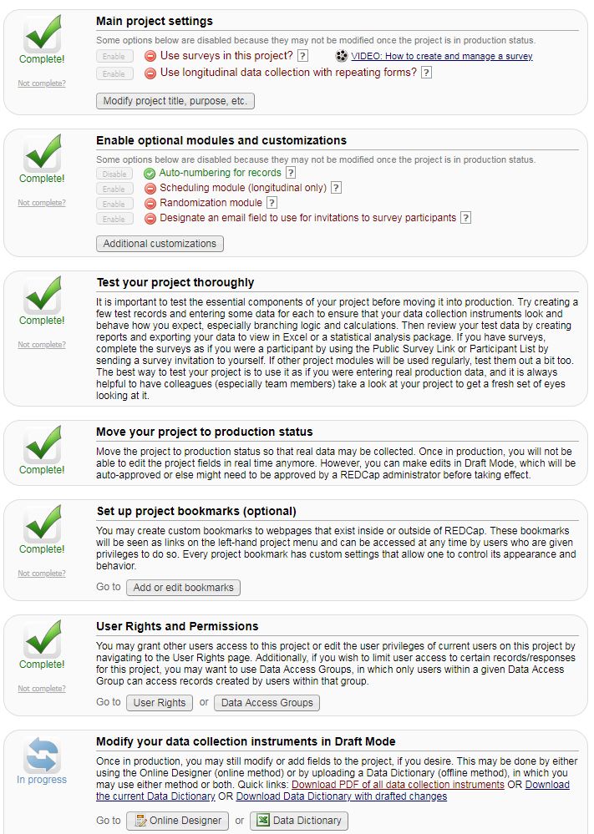
REDCap Project Development - Set Up
Notes:
As I mentioned earlier, REDCap does not require prior background knowledge or technical experience so when you set up a project, REDCap walks you through the process. Here is the project set up page. REDCap is completely customizable, and we built our project from the ground up which took months of work. There is a shared library, but the Healthy Start screening tools are not available. Therefore I’ll go over some of capabilities and features for project development.

Slide 16
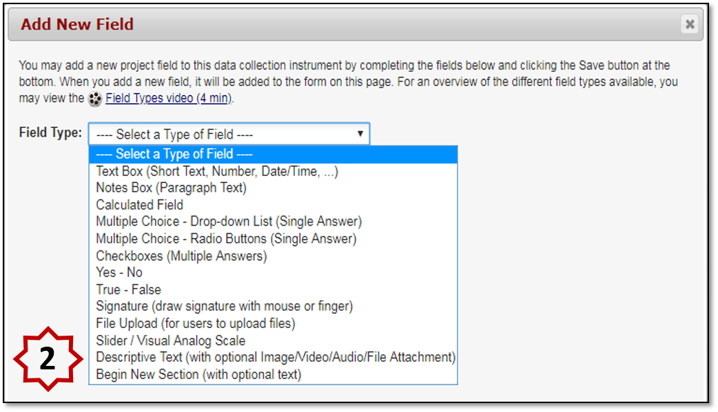
REDCap Project Development
Offline - Data dictionary created in CSV file. This method is often suggested for larger projects.
Online Designer
Modes include development; production; draft
Notes:
What does project development look like? You can build your project via the online designer or offline in the data dictionary which is a CSV file. (#1)
You can use either, but the online designer is more point and click and makes project development accessible to anyone. However, the offline method is suggested for large projects.
The second screenshot here is of the dialogue box that appears when you start to create fields in your instrument or form. Here you can select the field type you would like use. We use the following most frequently:
Text box
Notes box
Calculated field
Multiple Choice – Drop-down List
Multiple Choice -- Radio Buttons
Checkboxes
File Upload
I will point out these fields when we get into the data entry portion of our presentation.
Other fields we use are: (#2)
Descriptive text and begin new section. These are great to format your instruments. You can also format text and the background using HTML tags. “HTML tags are the hidden keywords within a web page that define how your web browser must format and display the content.” If you are unfamiliar with this there are many resources online.

Slide 17
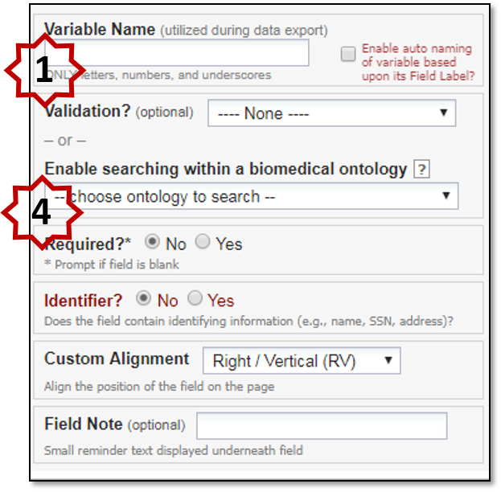
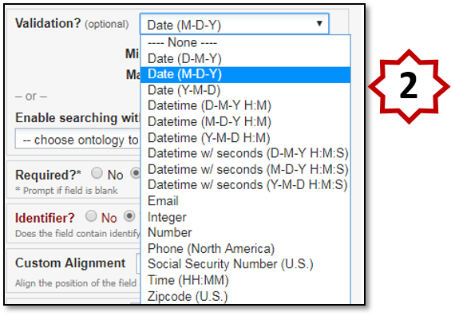
REDCap Project Development - Field Validation
*This is a nice feature for birthdays.
Notes:
After you select the type of field you want, you can add (#1) validation to the field. The example I have is here is for a date field. As you can see, you can select how you want the date to be formatted, and in this case, it is (#2) Month – Day – Year. When you select this type of validation a calendar icon will appear next to your field and this allows those who are entering data to click today or select the calendar and pick a date. This is a key feature because the screening tool implementation guides indicate allowed values such as mm/dd/yy or an integer with a value range.
Another feature of REDCap is the use of action tags. The example I have here is the @HIDEBUTTON which will hide the 'Today' button that is typically displayed to the right of date/time fields. This is helpful for fields where ‘Today’ will never be the appropriate response. An example would be the Date of Birth for the mother. (#3) REDCap provides a lot of information and training within the software and what I have circled is an example of how you can learn about the Action Tags while you are creating your project.
A couple other features you might want to note are: (#4)
Required fields which prompts a popup reminder to complete the field before saving and moving to a different instrument
Custom Alignment which allows you to do some formatting of your field.
Field Note which is helpful to guide data entry with a reminder such as “check all that apply”

Slide 18
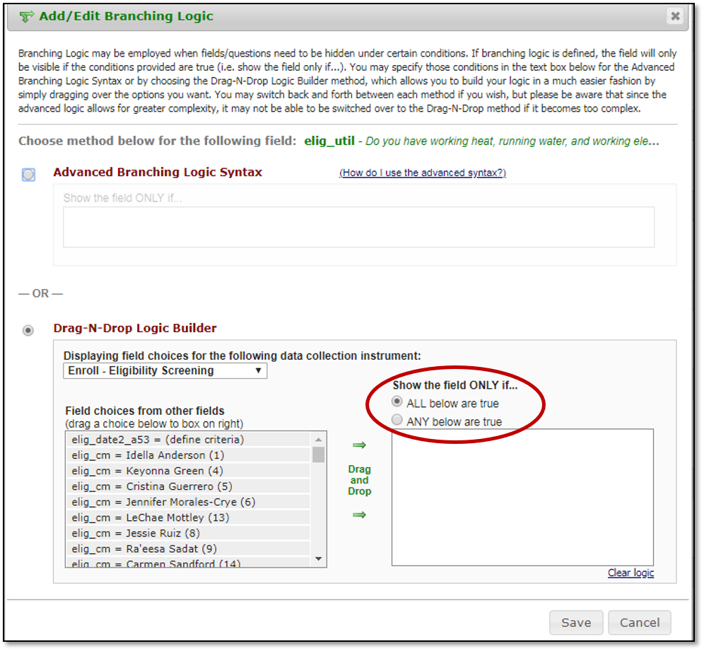
REDCap Project Development - Branching Logic
Example of Advance Branch Logic Syntax: ([gender]=‘1’ and ([age] >10 and [age]<50)) or ([gender]=‘2’ and ([age]>10 and[age]<50))
Drag-N-Drop Logic Builder: Most frequently used the screening tools
Notes:
After you’ve created a field you can determine when it will be displayed to those entering data. This is called Branching Logic, also known as skip logic. Branching logic can only be applied to each field. (CLICK)
There are two approaches to branching:
(CLICK) The advance branching logic. This is where you can write your own syntax, and I have an example from the internet. A field with this branching logic would only appear if the participant was a male or female between 10 and 50 years of age.
(CLICK) The basic: This is where you drag and drop fields into the dialog box and then select (CLICK) if all the statements or if any of the statements are true.

Slide 19
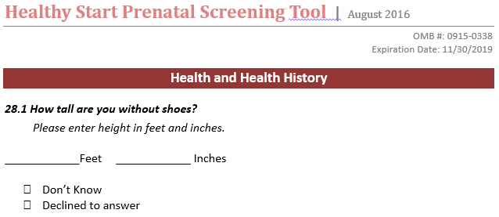
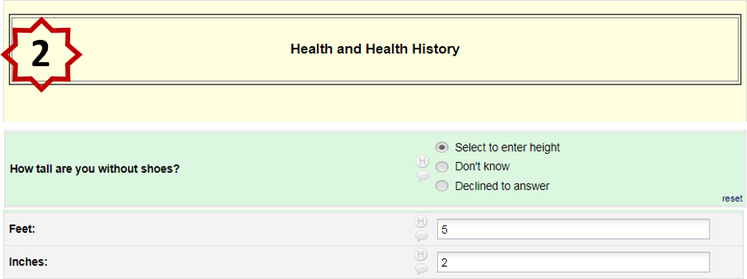
Project Development – Adapting Screening Tools Using Branching Logic
Notes:
Here is an example of REDCap’s branching logic using the Prenatal Screening Tool question “How tall are you without shoes” The response options include don’t know, decline to answer, and entering the height.
Using HRSA’s prenatal screening tool, we developed our prenatal form in REDCap. As you can see, we incorporated the same question about the mother’s height. However, to simplify the form we chose to use branching logic that reveals questions that are applicable according to the mother’s answers.
If the mother says she does not want to answer how tall she is, clicking the “Declined to answer” option tells REDCap that there is no more information to collect pertaining to the mother’s height.
However, if the mother reports her height, the case manager will select the first field “select to enter height” CLICK which triggers REDCap to reveal CLICK the “height” and “inches” fields.
Hiding the field that isn’t applicable not only makes the form easier to read by the Case manager but also reduces the likelihood for human error thus ensuring data quality.

Slide 20
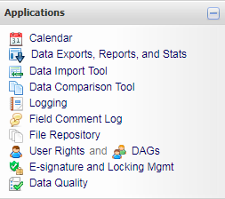
REDCap Project Development – Other Features
Training videos within REDCap
Applications
File Repository
Notes:
Lastly, there are a couple other features of REDCap.
Training – As I’ve mentioned before, there are training resources including a Training Resources tab and embedded videos. (#1) Video topics include general REDCap, project types, project build, data entry, and special features.
Applications – REDCap comes with a lot of applications you can use including a calendar that you can enter events in, data export, data import, logging (which tracks REDCap user activities), field comment log, and file repository which is seen pictured to the right. The file repository is where WHS keeps our consent forms so case managers always have access to blank copies. Users just have to click on the paper with the green arrow to initiate the download.
As with all the things I’ve discussed so far you can make it as customizable as you want.

Slide 21
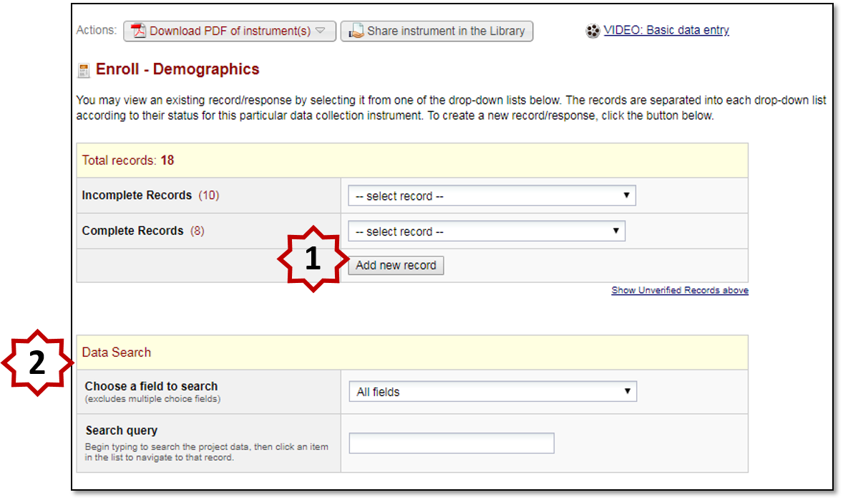
Data Entry
Notes:
After developing your project instruments or forms, data collection begins. This is a screenshot where case managers create new records when they enroll a new participant. WHS uses an automatic numbering system so when you select (#1) “add new record” a record ID is automatically created. If you have data access groups, then the enrollment will be assigned a data access group based on who enrolled the participant and a number associated with the data access group will a part of the record ID. For example, with a DAG the record ID 9-62.
This is one thing we had to work around the HSMED upload. We created a field that holds a Healthy Start participant’s unique Identifier, and Sarah will talk about that later in the presentation.
Case managers can also (#2) look up records under “data search” to continue data entry for participants that already have a record ID. You can look up participants by their record ID, name, MRN or any other field in REDCap.

Slide 22
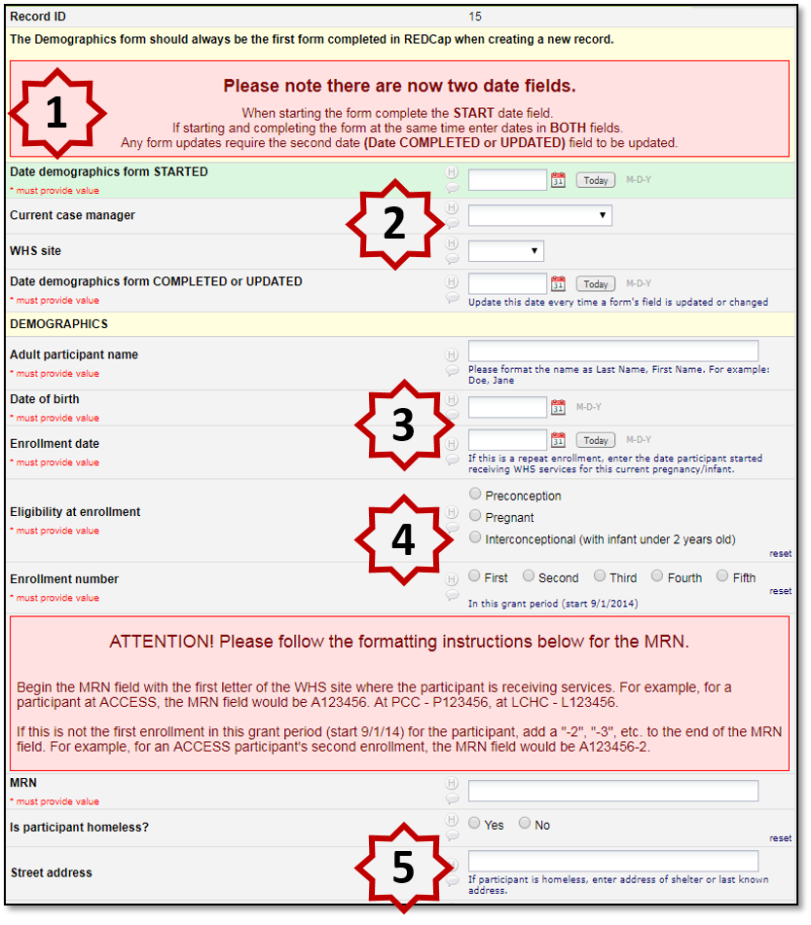
Data Entry – Demographic Form
#1 - This is an example of using Begin New Section field type and the formatting you can achieve with HTML tags.
#3 - This is an example of date field validation and use of the @HIDEBUTTON Action Tag.
#2, #4, and #5 - These are examples of the different field types and formatting of the field types.
Notes:
Here we have a portion of the WHS demographics form. This is what Healthy Start staff will see when entering data.
#1 At the top of the form you can see an example of the field type ‘begin a new section’ and the type of formatting you can achieve with HTML tags.
#2 Next at #2 we have an example of a Multiple Choice – Drop-down List field type
#3 We can see an example of the use of field validation for a text field. You can see a calendar icon and a today button with the enrollment date while for the date of birth we used the @HIDEBUTTON action tag and therefore the today button is hidden.
Lastly, we can see a couple more examples of field types with different formatting and alignment.
#4 You have the Multiple Choice -- Radio Buttons which are seen as both vertical and horizontal
#5 Lastly, we have another use of the text field with a field comment that gives directions regarding the address

Slide 23
Data Entry – Case Management Perspective
REDCap allows for a real time look at both the individual participant’s record as well as the caseload overall
Reports within REDCap allow Case Managers, Breastfeeding Counselors, and our CAN Coordinator to organize their work by stages of care
REDCap’s customizable instruments supported the development of encounters and care plans
Pros: Case Managers individualize care plans and report encounters with ease. Supports the supervisors ability to audit staff for performance evaluations and fidelity to the program
Cons: Double data entry – REDCap and EMR documentation
Notes:
Dara
An example of utilizing REDCap reports to organize their work by stages of care: (i.e. upcoming deliveries, participants currently breastfeeding etc.), screening tool management, and even demographics (i.e. homeless participants report)

Slide 24
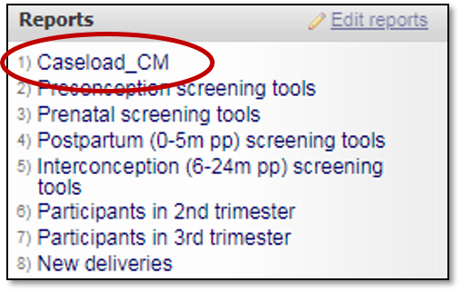
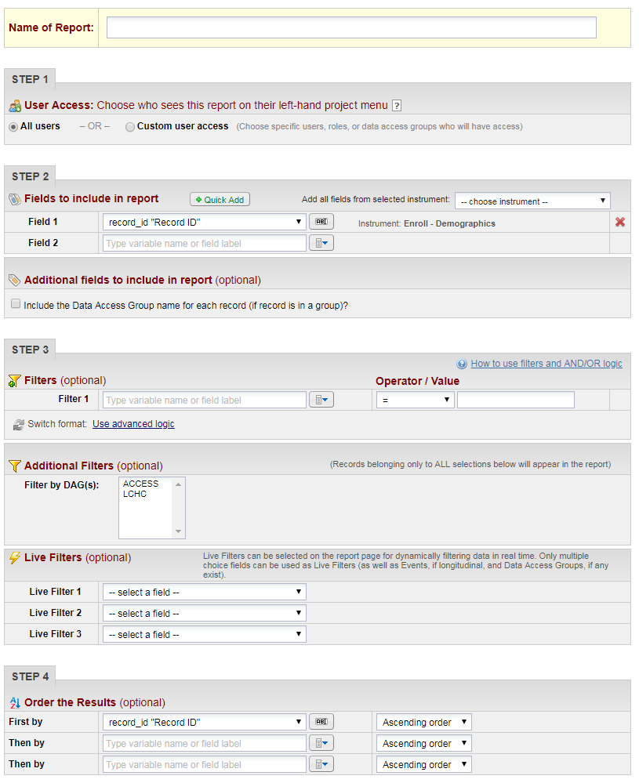
REDCap Reporting
Report Development Steps
User Access
Columns/fields
Filters
Order of results
Notes:
Sarah
Reporting in REDCap can be for both project staff and evaluation. Case managers and breastfeeding counselors use reports to monitor caseload, screening tool completion, and outreach. CLICK Available reports such as the caseload report will show up on the REDCap users navigation column under reports.
Program directors and managers view reports for staff auditing and CAN recruitment. Evaluation uses reporting to pull data for enrollment, aggregate, and performance and progress reports.
Like most features, REDCap walks you through report building. It is broken up in to 4 steps:
User Access: You can control access to the reports. It can be available to all REDCap Project Users or custom
Columns/fields: You can pull in an entire instrument (example demographic form) or select variables from many instruments
Filters: This affects who pulled into the report (for example participants enrolled after the start of the grant year). Similar to branching logic you can use point and click and AND/OR logic or you can use advanced logic which allows you to hand-type the logic.
Additional filters include:
DAGs
Live filters (For example the caseload report that pulls in all open participant enrollments and case managers can filter to only see their participants.)
Order the Results: This determines how the participants are displayed in your report. You select a variable in your report and decide if it’s in ascending or descending order. For example you could order by site, or case manager or enrollment number.

Slide 25
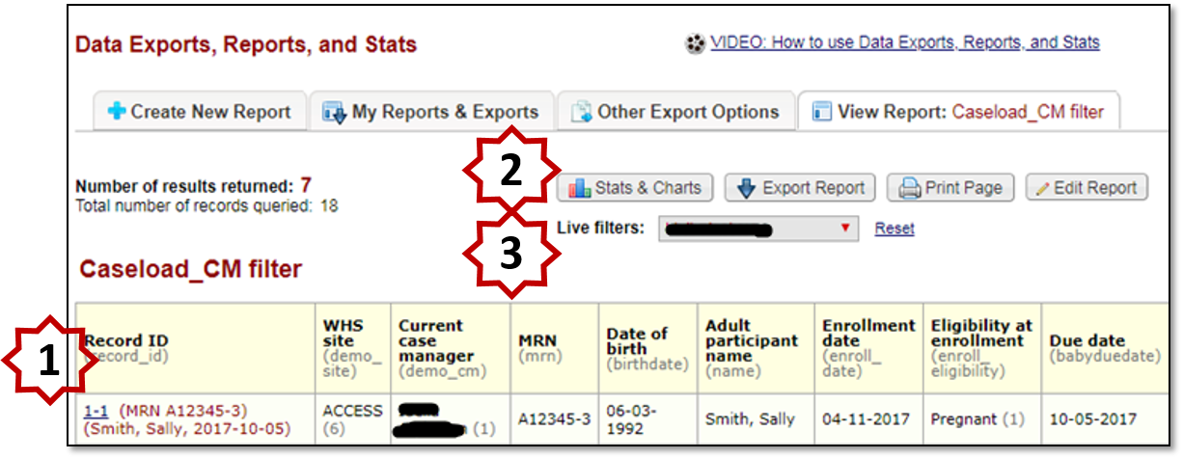
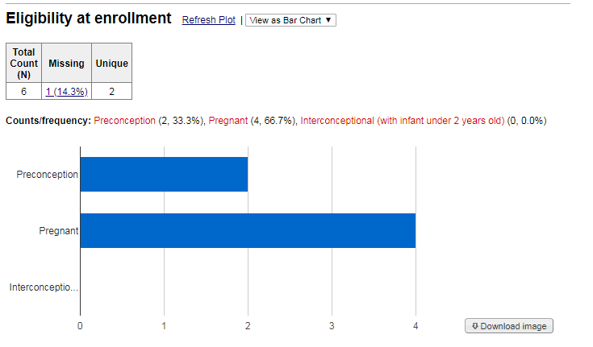
REDCap Reporting - Features
Notes:
When you open a report you’ll be able to see all the columns and data pulled into the report. This is a copy of the caseload report from our training project that has fake data. Here you can see a number of the features:
#1 The record ID is a hyperlink and if click will bring you to their REDCap record.
#2 You can look at stats and charts from your report. This is a built in feature and you can see what that looks like in the screenshot down to the right
#3 Lastly, there is also the live filter. This allows a staff member to filter for their own name to monitor their caseload.

Slide 26
REDCap Exporting Data
Export options: All data, selected instruments, or built reports
Export into the software of your choice
Notes:
Certain REDCap project users will have the ability to export data depending on their user rights. You can export all data, selected instruments or your built reports. You can also select what software you are going to export your data too.
The following slides will walk you through what it looks like when you select “make custom selection.”
CLICK

Slide 27
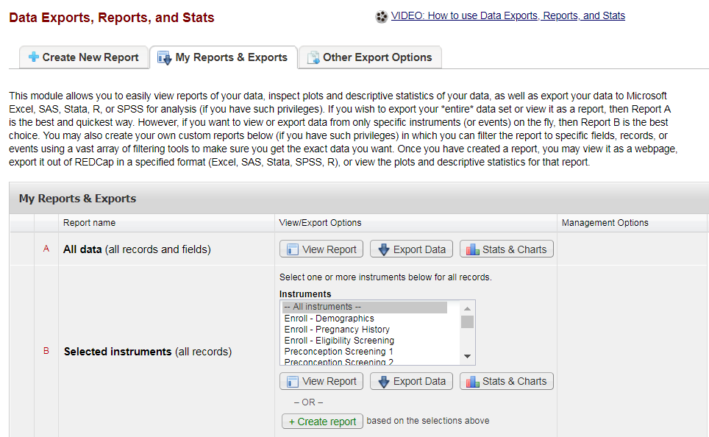
HSMED Upload – Instrument Selection
Can use combinations of instruments to pull the data needed for HSMED Upload
Once instruments are selected, can export to any of the formats mentioned on previous slide
Notes:
Once you click “make custom selection” REDCap gives all instruments in a dropdown list, and you are able to select any number of combinations
Once the desired instruments are selected, you can either view the data by clicking “view report” or export client-level data by clicking “export data.” When you click export data CLICK

Slide 28
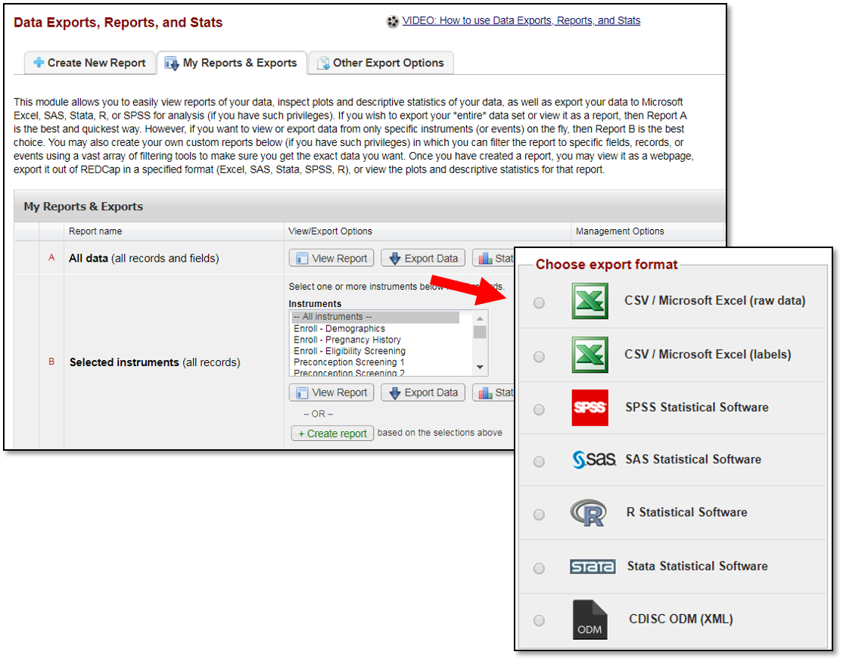
HSMED Upload – Instrument Selection
Can use combinations of instruments to pull the data needed for HSMED Upload
Once instruments are selected, can export to any of the formats mentioned on previous slide
Notes:
REDCap generates a list of options for this export including SAS, SPSS, STATA, R, Excel, XML
For WHS, we typically use Excel and SPSS to conduct analysis. For the HSMED upload, we use SPSS to process the data into the required format for the upload.
For cost purposes, we use SPSS and this program is really user friendly since it gives drop down options meaning you do not have to build your code from scratch. R, SAS, and STATA are great programs as well – user preference and cost will determine which program is best for you.
It is important to note that the XML feature is an option here, however due to the way REDCap codes certain variables this export is not compatible for the HSMED upload. Meaning, we cannot directly export from REDCap for the HSMED upload. Instead we need to export it to a different program in order to be able to transform some of the data into the correct format for the upload which is a fairly laborious process and something for programs interested in this database to keep in mind.
CLICK

Slide 29
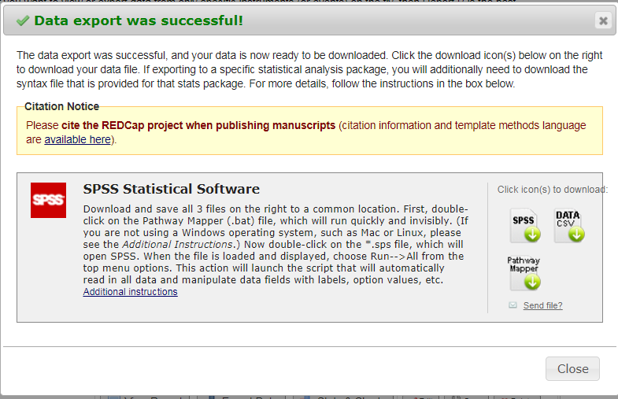
HSMED Upload – Exporting Syntax
Exporting REDCap data to SAS or SPSS generates 3 different files
CSV – raw data
Syntax file (SPSS)
Pathway Mapper
Always need to open the pathway mapper before the syntax file
Using R or STATA simply exports the CVS and syntax file
Notes:
Once you select the export format your want, REDCap will generate files as shown in the box to the right
REDCap gives all the instructions to the left of the files, but simply double click on the files to download them. The main thing to remember is that the pathway mapper needs to be opened before the SPSS syntax file because that allows for your computer to automatically populate the location of the CSV file within the syntax, but if you forget you are able to manually type it into the syntax REDCap gives.
Also of note is that REDCap only generates 2 files for R or STAT exports, the pathway mapper is not necessary for these exports.
CLICK

Slide 30
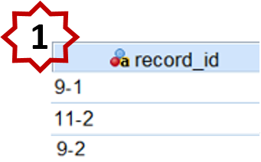
HSMED Upload – Data Processing
This is an example of how we combine REDCap’s automated ID generating system with our own criteria to further distinguish our clients and ensure data quality
* This comes from data that was exported into SPSS
Notes:
Following the HSMED system guidelines, we are required to use one client unique identifier for each Healthy Start participant. If a participant has more than one pregnancy/enrollment in Healthy Start, their data should be submitted under the same client unique identifier. Further, each ID must be an alphanumeric text string ranging from 1 to 50 characters that contains no Personal Identifying Information.
WHS uses the record ID (record_ID) field in REDCap as the client unique identifier (UCI), and if the participant has more than one pregnancy/enrollment in Healthy Start, their first record ID is used as the client unique identifier. The field called the HSMED Unique Client Identifier, seen on this form here, is populated with first record ID if a participant has more than one pregnancy/enrollment. This helps us pull clients’ pertinent data from forms we used before the development of the standardized screening tools, and ensures we are not duplicating clients’ records or information and are aware of every participants’ encounters.
As mentioned earlier, the case manager’s data access group results in a specific number being a part of the record ID. We do this because our organization consists of multiple health centers that patients can visit, so we can use the UCI to distinguish the clients further as seen by #1.
In the example of #1, Client 1 was seen at clinic A so she received the ID 9-1. The next client, Client 2, was seen at clinic B so she received the ID 11-2. Client 3 was also seen at clinic A, so, again, the leading number is the same as the first and REDCap generates a second ID for this site giving this client a UCI of 9-2.
Once we process this data in SPSS we are able to remove the hyphens to generate IDs with only numbers.
The Next Slide will go over another example of data processing required for the HSMED upload
CLICK

Slide 31
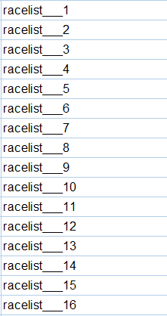
HSMED Upload – Data Processing Continued
REDCap’s Export
Variable for HSMED
Notes:
Another important data processing step includes restructuring nominal fields – for instance, when we export race, each value of race is exported as its own variable as shown here on the left. These are 16 different, dichotomous variables that represent the 16 field values for race. In order to get this variable formatted correctly for the HSMED upload we first have to change each variables’ dichotomous value into the correct nominal value (1 for racelist__1, 2 for racelist__2, etc).
Once the variables are assigned their corresponding value, they are ready to be transformed into the final, desired version - one race field with each value separated with a comma in order to meet the standards for the HSMED upload.
The ability for participants to report multiple races is advantageous for the Healthy Start program overall but it creates some difficulty when processing variables such as this race variable– and with the number of nominal variable included in this HSMED upload this makes the data processing from REDCap exports a bit tedious.
CLICK

Slide 32
Conclusion
Pros
Cons
No up-front cost
Intuitive - no previous experience required
Web-based
Customizable
Validation includes range checks, data type checks, valid date checks, and branching logic
Ability to support multiple projects
Requires personnel time for installation and management (1.5 FTE for 6 month build)
Strictly a data collection tool/database
Requires software and personnel with coding experience to process data for the HSMED upload
Most compatible with Google Chrome (lags in other servers)
Notes:
Timika
The pros include:
Web-based → can disseminate surveys via mobile devices
Customizable → could also be a con because there are no templates to use, must build all forms and instruments from scratch
The cons include:
Limited Technical Support

Slide 33
Contact Information
Timika Anderson-Reeves, Program Director
Timika.Anderson@achn.net
Dara Gray, Program Manager
Dara.gray@achn.net
Sarah Pylant, Data Management Specialist
Sarah.pylant@achn.net
Lindsay Zeman, Evaluation Specialist
Lindsay.zeman@achn.net

Slide 34
ChallengerSoft
Lisa Bain, Project Director, California Border Healthy Start
James A. Counts, Social Services Manager, San Antonio Healthy Start

Slide 35
ChallengerSoft | Overview
Why did your program select this platform?
California Border Healthy Start | San Antonio Healthy Start
Well-known: host to many Healthy Start sites Experience: Staff have Healthy Start backgrounds Relationship: staff are easy to get in touch with and provide a lot of support | Worked with ChallengerSoft in the past Experience: Healthy Start has knowledge of the work of ChallengerSoft Relationship: Staff has familiarity with the system
Notes:
Resources needed Cost (estimate/range, if possible) Time commitment / staff resources to start-up and management Staff use/training

Slide 36
ChallengerSoft | Integration with HS
Monthly progress reports / Performance reports
Based on “CORE” Forms, which are required in addition to the screening tools
Results available through push button reports, but need to be supplemented by queries
Screening Tools
All there, but some cells are not validated and not connected to push button report
Data entry / management
We think this system requires at least 1 person to spend 25-50% cleaning and pulling data, in addition to staff that enter data.
CBHS - all 9 HV enter data, 1 day a week for data entry (20% = 1.8 FTE)
San Antonio has 3 data entry staff that spend 50% of their time on Challenger (1.5 FTE)

Slide 37
ChallengerSoft | Pros / Cons
Are there data validation options with programming?
Validation is not currently included for screening tools
Security considerations
Secure server - “https://”
Levels of access ensure not all users can delete important data
System does not log a user out - requires individual users/screens to “sleep” to meet HIPPA criteria.
Timeliness (data entry, data processing, etc.) expectations
Fairly time consuming
CBHS - currently collect data on paper, then enter at the office
Custom forms – availablity?
With significant additional money and time; not much delivered to date

Slide 38
ChallengerSoft | Pros / Cons
Pushbutton reports complete? Pushbutton work as a standalone? Monthly reports complete?
Pushbutton reports complete bust most require additional queries for accuracy
These are based on CORE forms
Case Management
Overall easy to find participants and their children
Hard to access data within a participant record - have to go to another screen
Export / HSMED upload compatibility
A few clicks to export
Sometimes errors when uploading related to data entry (Screening tools don’t have validated cells)
Challenger willing to edit xml files quickly when a system error come ups

Slide 39
Key Takeaways
HS programs have many options and functionalities to consider when selecting a new data platform.
The best approach for confirming whether a platform is appropriate for your program is to speak directly with a vendor.
Grantees can access peer guidance and resources from the HS EPIC Center to provide background research.

Slide 40
Questions?

